Slide 1
Error characterization project
Weekly updates
Feb.20.2026

Slide 2
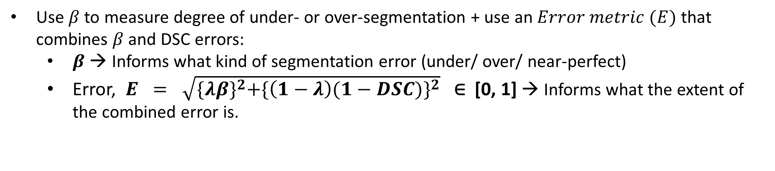
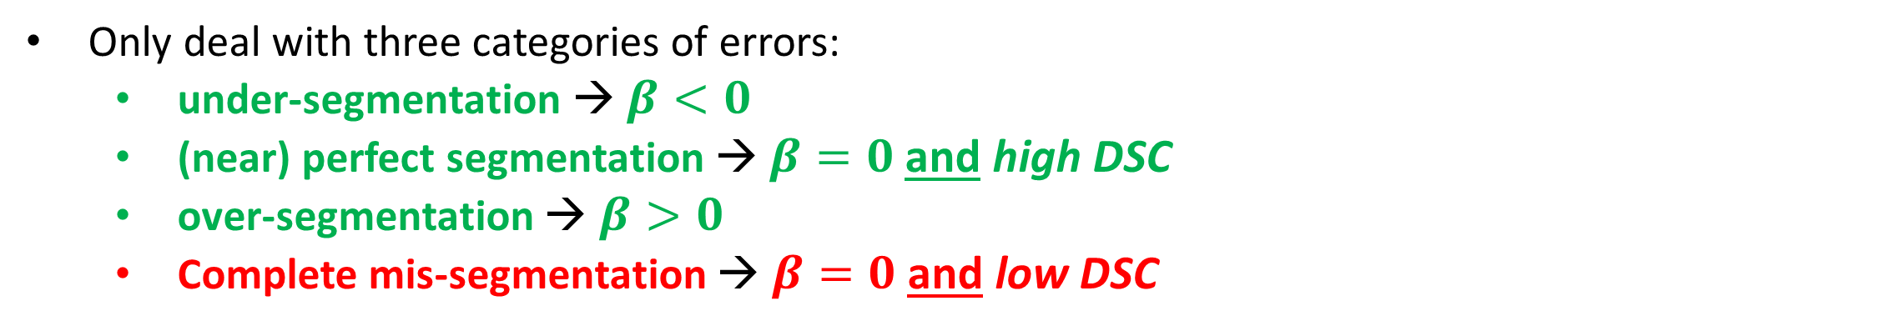
Proposed changes to methods
– What categories to focus on? What scores to consider?
Proposed: A slight change in method
Only deal with three categories of errors:
under-segmentation → $β<0$
(near) perfect segmentation → $β=0$ and high DSC
over-segmentation → $β>0$
Complete mis-segmentation → $β=0$ and low DSC
Use $β$ to measure degree of under- or over-segmentation + use an $Error metric (E)$ that combines $β$ and DSC errors:
$β$ → Informs what kind of segmentation error (under/ over/ near-perfect)
Error, $E = \sqrt{{\{λβ\}}^{2}+{\{\left(1−λ\right)(1−DSC)\}}^{2}} \text{∈ [0, 1]}$ → Informs what the extent of the combined error is.
Next page: Recap of these categories

Slide 3
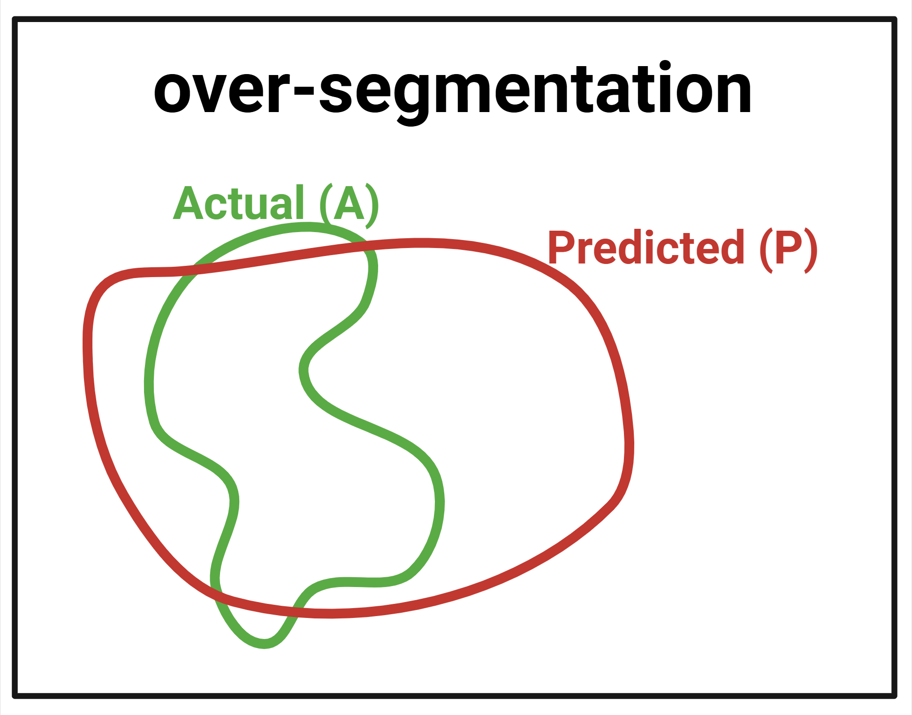
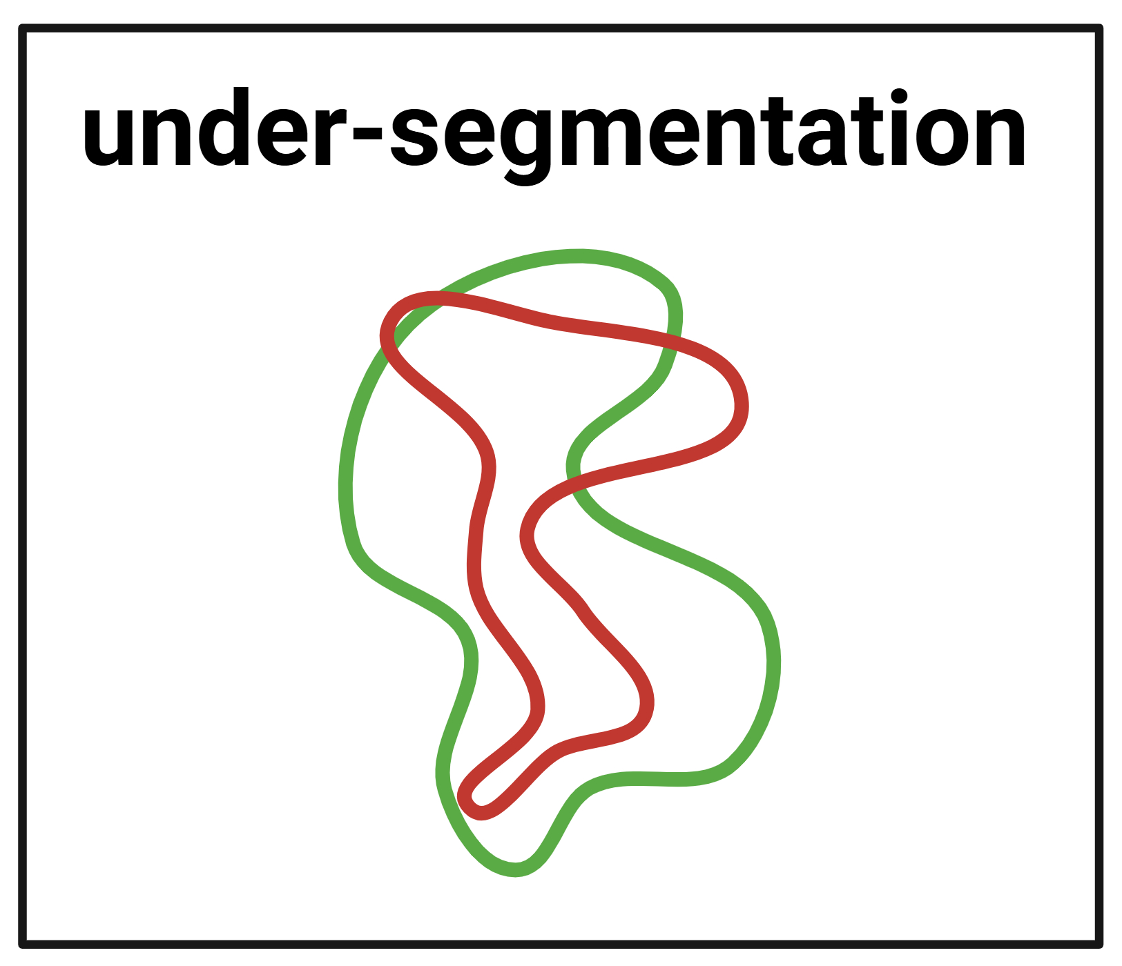
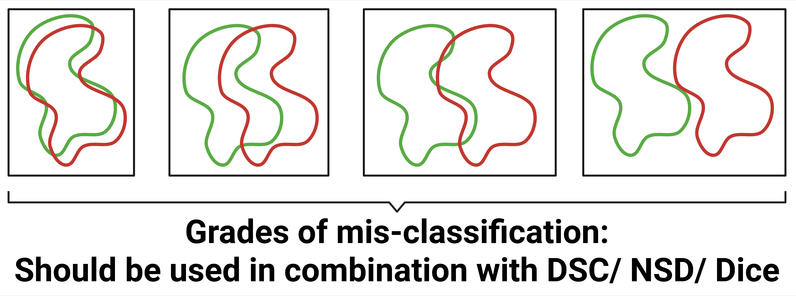
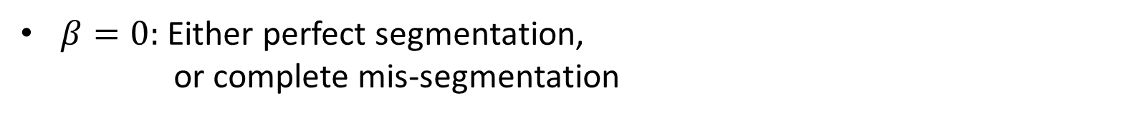
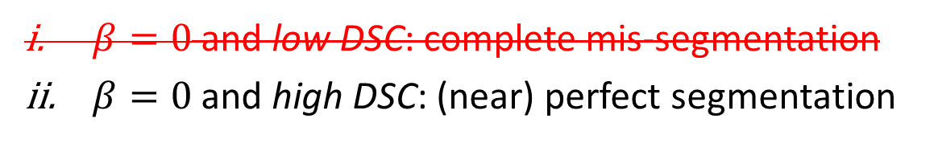
Methods
– Recap of the segmentation error categories
Segmentation error categories
SA-based error score, $β=\frac{Surface area \left(Pd\right)−Surface area (GT)}{Surface area (GT)}$
Volume-based error score, $β=\frac{Volume \left(Pd\right)−Volume(GT)}{Volume(GT)}$
$β>0:$ over-segmentation
$β<0:$ under-segmentation
$β=0:$ Either perfect segmentation,
or complete mis-segmentation
$β=0$ and low DSC: complete mis-segmentation
$β=0$ and high DSC: (near) perfect segmentation

Slide 4
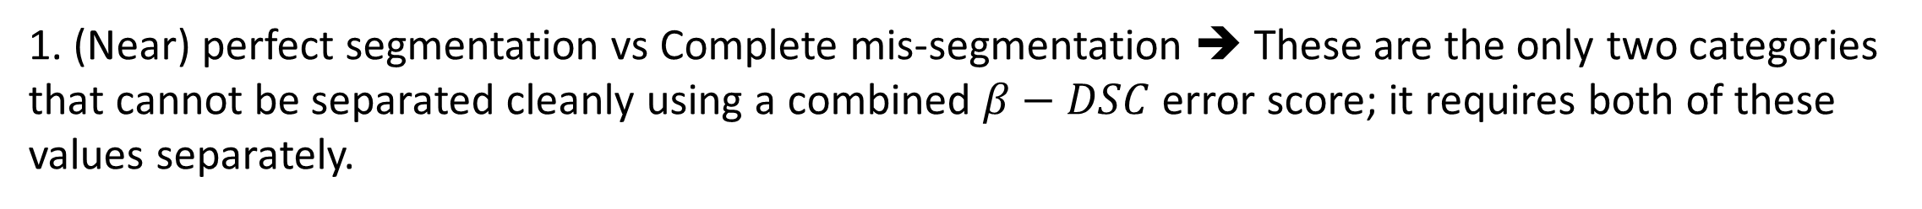
Methods
– Why to only consider under, good and over segmentation?
Why do I propose dropping the fourth category (complete mis-segmentation)
1. (Near) perfect segmentation vs Complete mis-segmentation ➔ These are the only two categories that cannot be separated cleanly using a combined $β−DSC$ error score; it requires both of these values separately.
2. Complete mis-segmentation is the only category that does not fit into the under/ over-segmentation bracket (the revised workflow).
3. (Near) perfect segmentation & Complete mis-segmentation ➔ Only two categories where the volume- and surface- $β$ (AND DSC) scores do not agree.
4. There aren’t many samples with this kind of error. → The TotalSegmentator model is good enough.
➔ Everything considered, it is probably easier to drop the complete mis-segmentation ($β=0$ and $low DSC$) category for now. The rest of the data fits cleanly within our methods.

Slide 5
Results 1 – Statistical
About the data
About the data – TotalSegmentatorV2-r-Sep.21.2023 [TS1, TS2, TS3]
1228 CT scans across 123 labels (117 anatomical structures).
Column “split”: 1082 train, 57 validation, 89 test
Total 89 test cases – but only 61 cases with non-empty stomach + liver + pancreas.
[TS1] TS paper: Wasserthal, J., Breit, H.-C., Meyer, M. T., Pradella, M., Hinck, D., Sauter, A. W., Heye, T., Boll, D., Cyriac, J., Yang, S., Bach, M., & Segeroth, M. (2023). TotalSegmentator: Robust Segmentation of 104 Anatomic Structures in CT Images. Radiology: Artificial Intelligence, 5(2), e230024. https://doi.org/10.1148/ryai.230024
[TS2] TS dataset, Zenodo: https://zenodo.org/records/10047292
[TS3] TS GitHub (model + results): https://github.com/wasserth/TotalSegmentator
Notes:
1. Add test or train set information.

Slide 6
Results 1 – Statistical
About the data
61 cases with non-empty stomach + liver + pancreas:
ct abdomen-pelvis → 11
ct thorax-abdomen-pelvis → 11
ct neck-thorax-abdomen-pelvis → 10
ct abdomen → 5
ct polytrauma → 4
ct thorax-abdomen → 3
ct thorax-neck → 2
ct angiography pelvis-leg → 2
ct angiography thorax-abdomen-pelvis → 2
ct spine → 1
ct angiography abdomen-pelvis-leg → 1
ct heart-thorakale aorta → 1
ct thorax-chest → 1
ct aortic valve → 1
ct angiography neck-thx-abd-pelvis-leg → 1
ct abdomen → 1
nan → 4
Notes:
1. Add test or train set information.

Slide 7
Results 1 – Statistical
About the data
61 cases with non-empty stomach + liver + pancreas:
Full test set with study type
Full test set with metadata
Full metadata
Notes:
1. Add test or train set information.

Slide 8
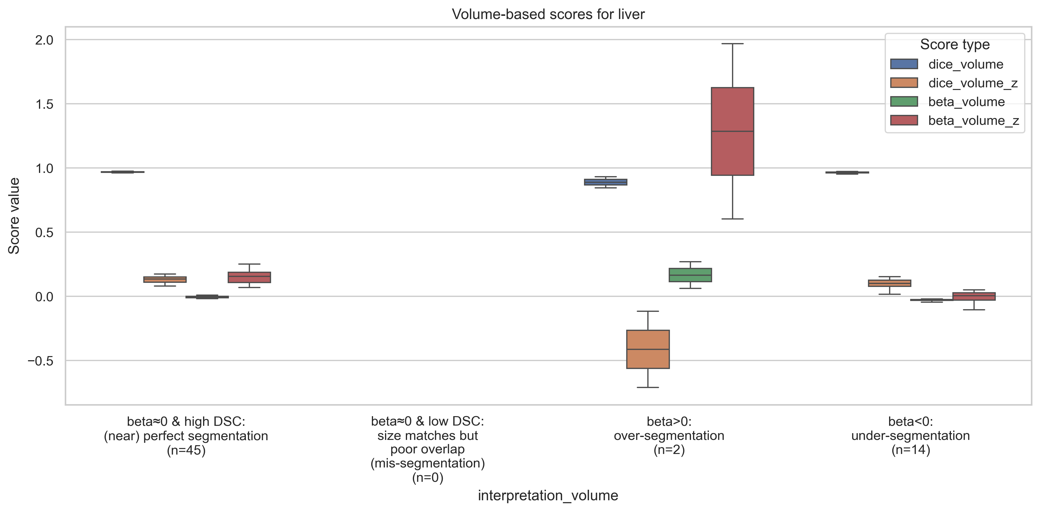



What do these error categories actually look like?
Liver (Easy – high DSC organ)
Volume-based error score, $β=\frac{Volume \left(Pd\right)−Volume(GT)}{Volume(GT)}$
$${DSC}_{high}=80\%=0.80$$
|$β_{tolerance}|=2\%=0.02$
$$\&$$

Slide 9
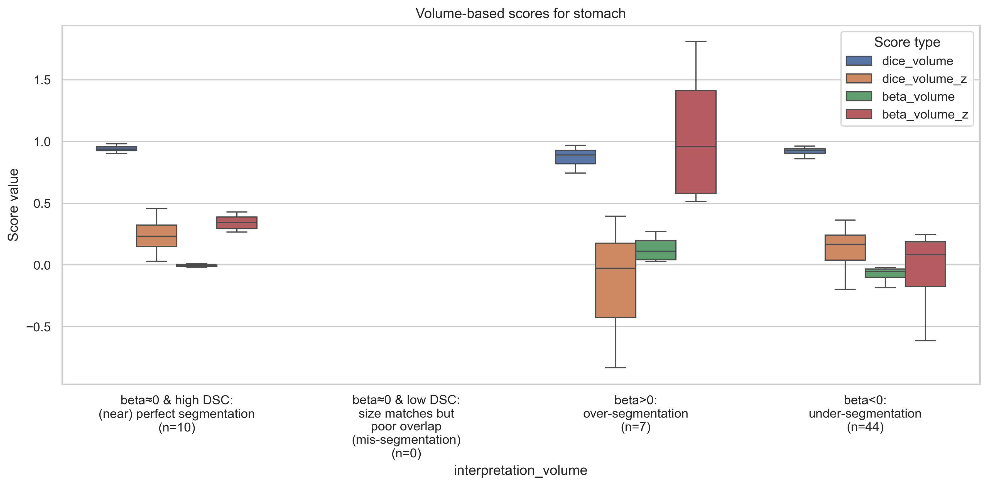
What do these error categories actually look like? (2)
Stomach (Moderate – medium DSC organ)
Volume-based error score, $β=\frac{Volume \left(Pd\right)−Volume(GT)}{Volume(GT)}$
$${DSC}_{high}=80\%=0.80$$
|$β_{tolerance}|=2\%=0.02$
$$\&$$

Slide 10
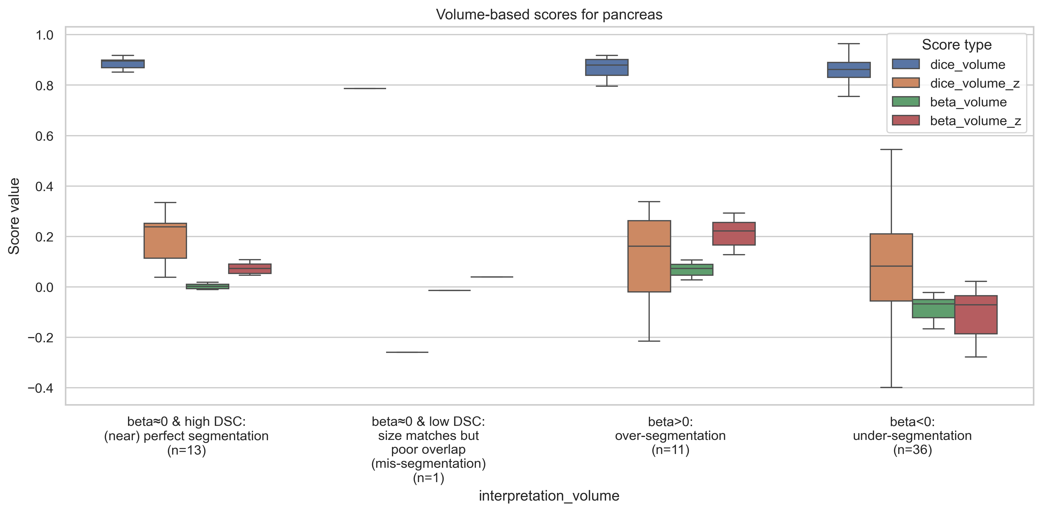
What do these error categories actually look like? (3)
Pancreas (Difficult – low DSC organ)
Volume-based error score, $β=\frac{Volume \left(Pd\right)−Volume(GT)}{Volume(GT)}$
$${DSC}_{high}=80\%=0.80$$
|$β_{tolerance}|=2\%=0.02$
$$\&$$

Slide 11
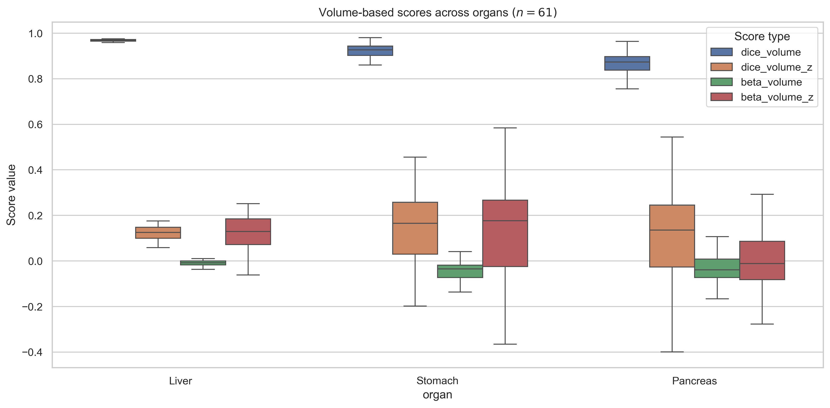
What insights can we draw from across organs?
– And, how removing “mis-segmentation” samples helps?
Across organs – Liver, Stomach, Pancreas
Volume-based error score, $β=\frac{Volume \left(Pd\right)−Volume(GT)}{Volume(GT)}$
$${DSC}_{high}=80\%=0.80$$
|$β_{tolerance}|=2\%=0.02$
$$\&$$

Slide 12
Proposed method ($β$ + $combined error E$)
Error, $E = \sqrt{{\{λβ\}}^{2}+{\{\left(1−λ\right)(1−DSC)\}}^{2}} \text{∈ } \text{[0, 1]}$
Assumption: During over-segmentation, $Area or Volume \left(Pd\right)≤2×Area or Volume (GT)$
Volume-based error score, $β=\frac{Volume \left(Pd\right)−Volume(GT)}{Volume(GT)}$

Slide 13
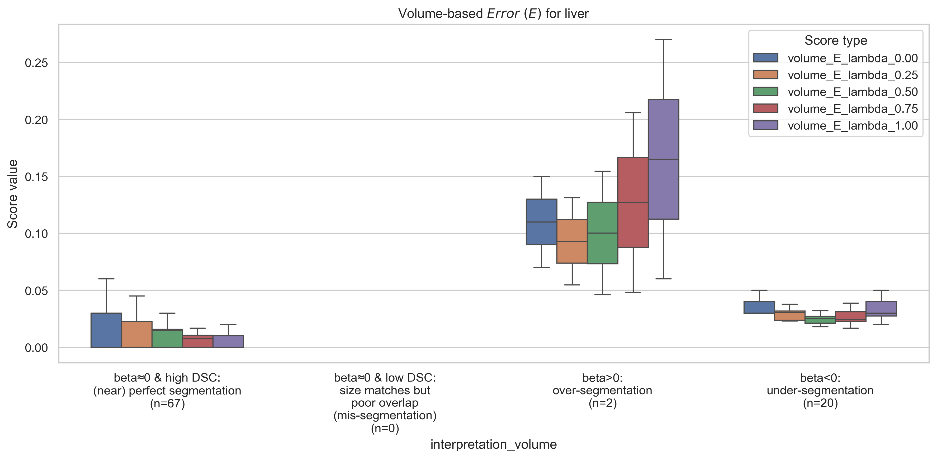
Proposed method ($β$ + $combined error E$)
Liver (Easy – high DSC organ)
Error, $E = \sqrt{{\{λβ\}}^{2}+{\{\left(1−λ\right)(1−DSC)\}}^{2}} \text{∈ } \text{[0, 1]}$
Volume-based error score, $β=\frac{Volume \left(Pd\right)−Volume(GT)}{Volume(GT)}$
$${DSC}_{high}=80\%=0.80$$
|$β_{tolerance}|=2\%=0.02$
$$\&$$

Slide 14
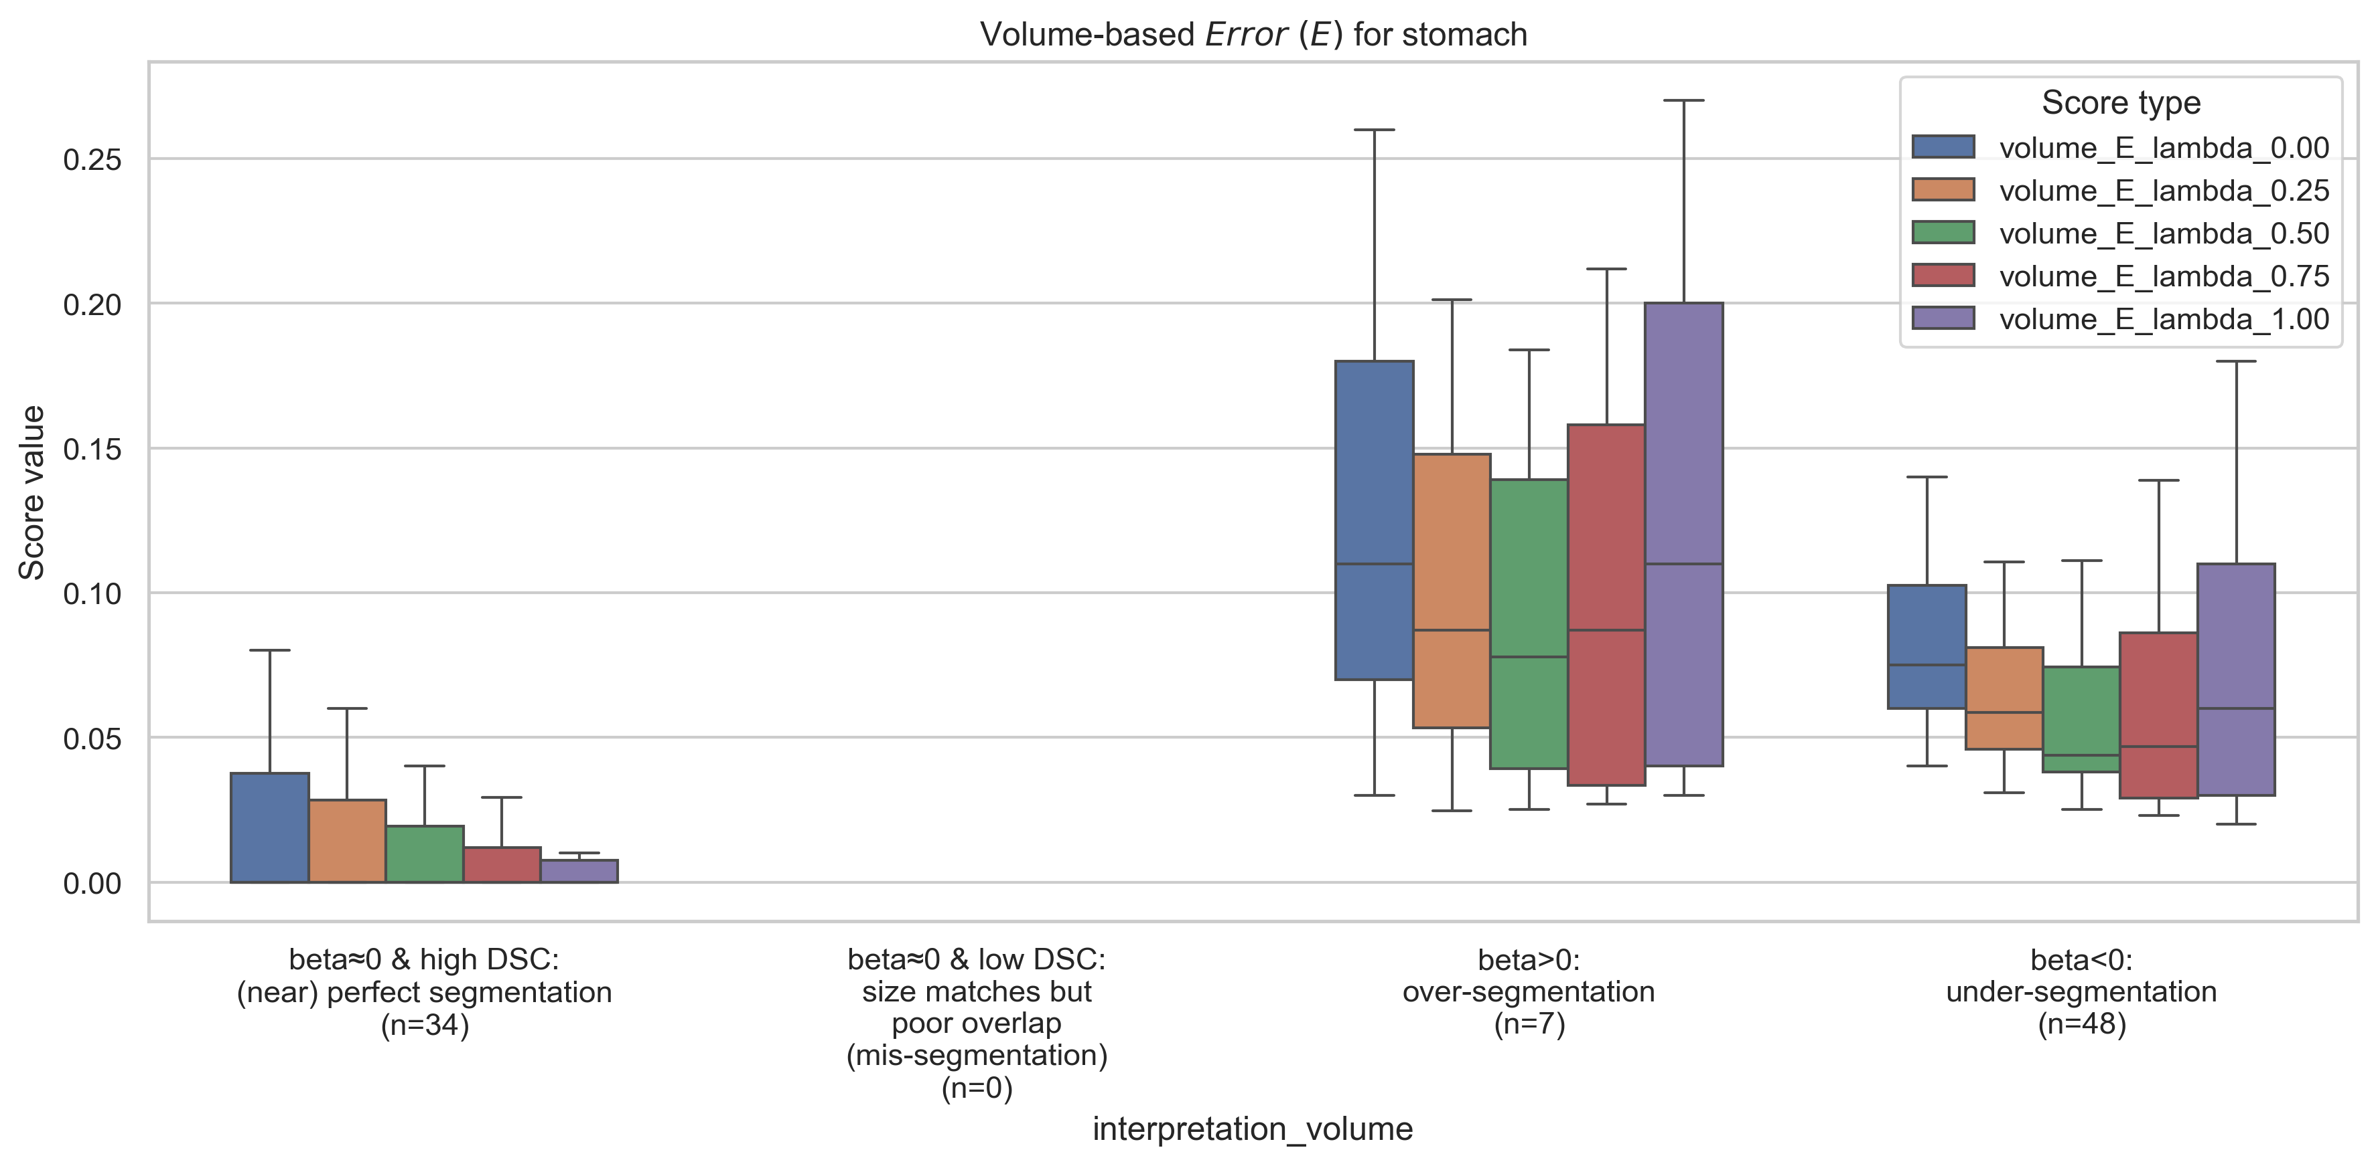
Proposed method ($β$ + $combined error E$)
Stomach (Moderate – medium DSC organ)
Error, $E = \sqrt{{\{λβ\}}^{2}+{\{\left(1−λ\right)(1−DSC)\}}^{2}} \text{∈ } \text{[0, 1]}$
Volume-based error score, $β=\frac{Volume \left(Pd\right)−Volume(GT)}{Volume(GT)}$
$${DSC}_{high}=80\%=0.80$$
|$β_{tolerance}|=2\%=0.02$
$$\&$$

Slide 15
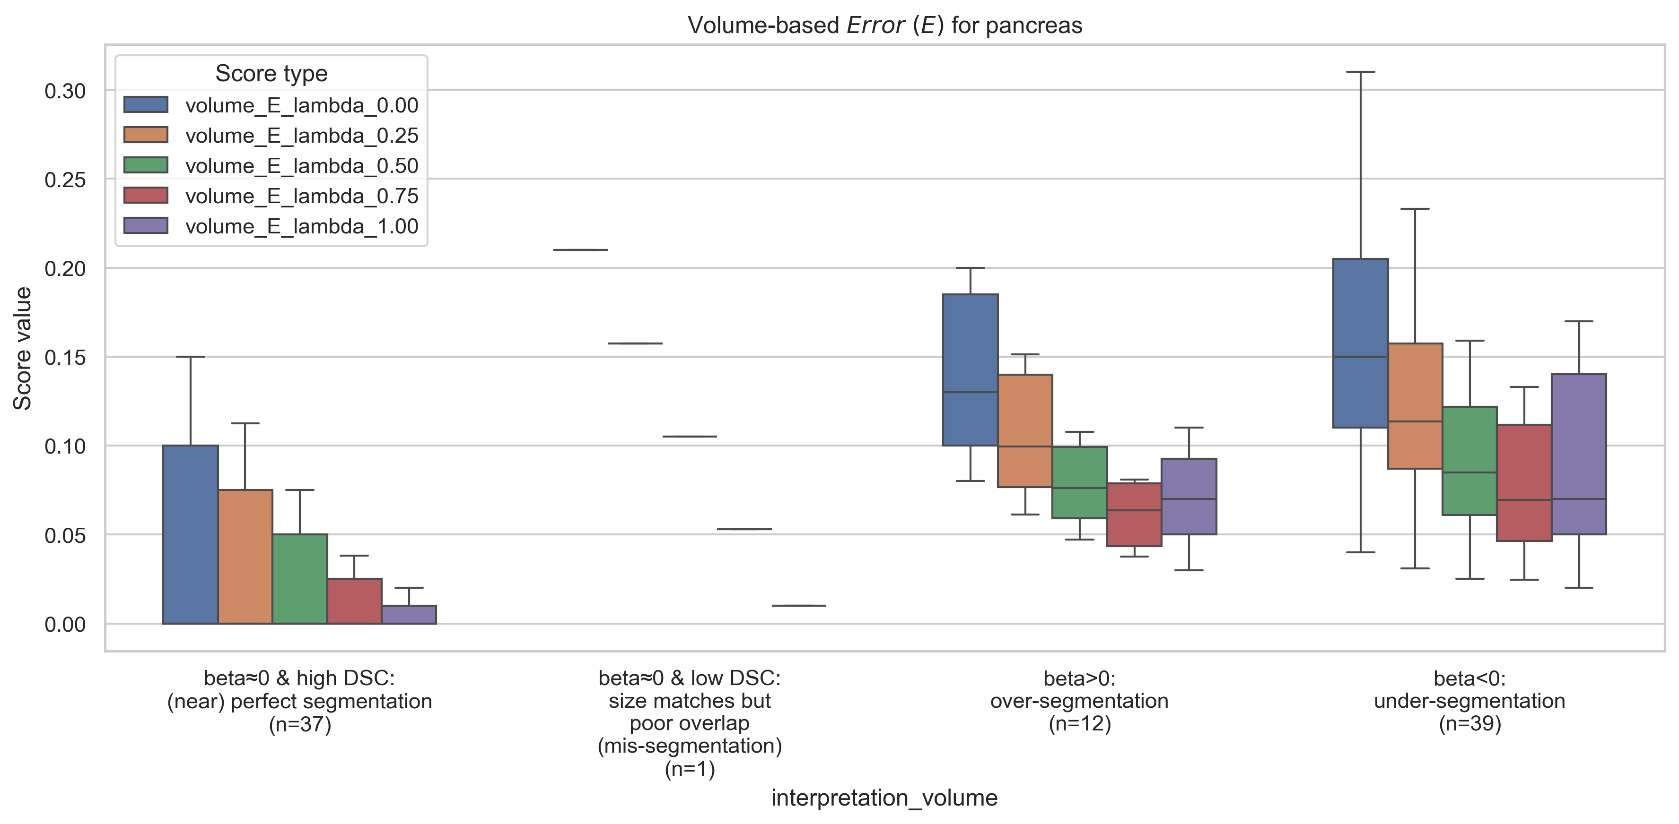
Proposed method ($β$ + $combined error E$)
Pancreas (Difficult – low DSC organ)
Error, $E = \sqrt{{\{λβ\}}^{2}+{\{\left(1−λ\right)(1−DSC)\}}^{2}} \text{∈ } \text{[0, 1]}$
Volume-based error score, $β=\frac{Volume \left(Pd\right)−Volume(GT)}{Volume(GT)}$
$${DSC}_{high}=80\%=0.80$$
|$β_{tolerance}|=2\%=0.02$
$$\&$$

Slide 16
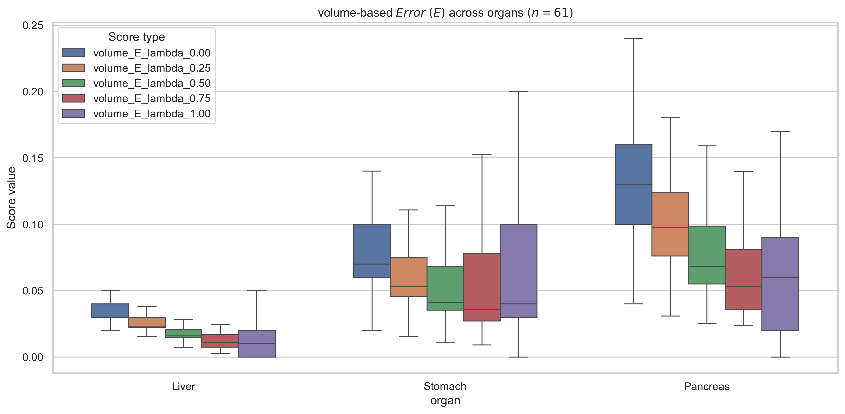
Proposed method ($β$ + $combined error E$)
— Across organs
Across organs – Liver, Stomach, Pancreas
Error, $E = \sqrt{{\{λβ\}}^{2}+{\{\left(1−λ\right)(1−DSC)\}}^{2}} \text{∈ } \text{[0, 1]}$
Volume-based error score, $β=\frac{Volume \left(Pd\right)−Volume(GT)}{Volume(GT)}$
$${DSC}_{high}=80\%=0.80$$
|$β_{tolerance}|=2\%=0.02$
$$\&$$

Slide 17
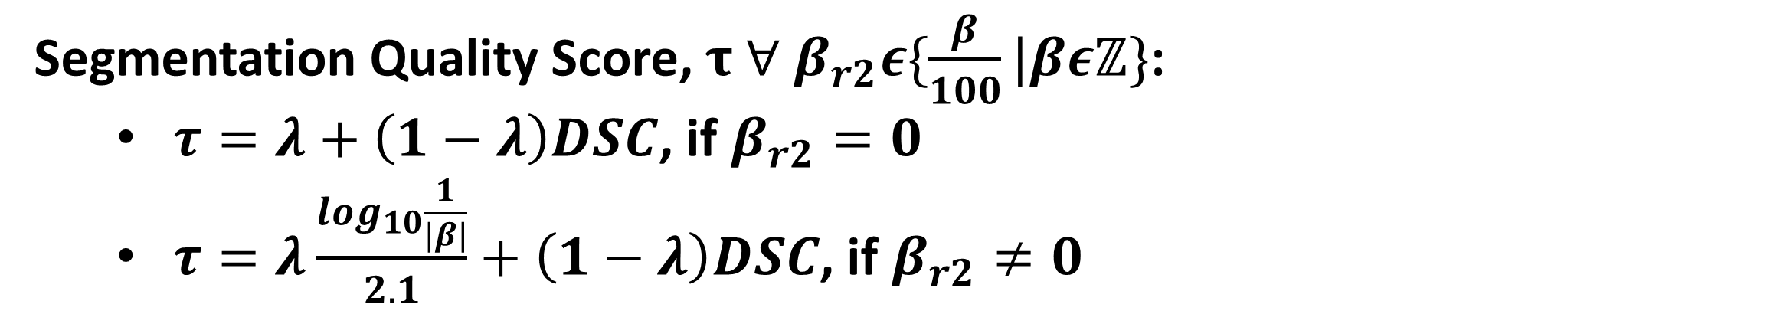
Proposed method ($β$ + $combined error E$) – with Quality of Segmentation Score $τ$
Segmentation Quality Score, $τ ∀ β_{r2}ε\{\frac{β}{100}|βεℤ\}$:
$τ=λ+\left(1−λ\right)DSC$, if $β_{r2}=0$
$τ=λ\frac{\log_{10}\frac{1}{|β|}}{2.1}+\left(1−λ\right)DSC$, if $β_{r2}≠0$
Assumption: During over-segmentation, $Area or Volume \left(Pd\right)≤2×Area or Volume (GT)$
Volume-based error score, $β=\frac{Volume \left(Pd\right)−Volume(GT)}{Volume(GT)}$

Slide 18
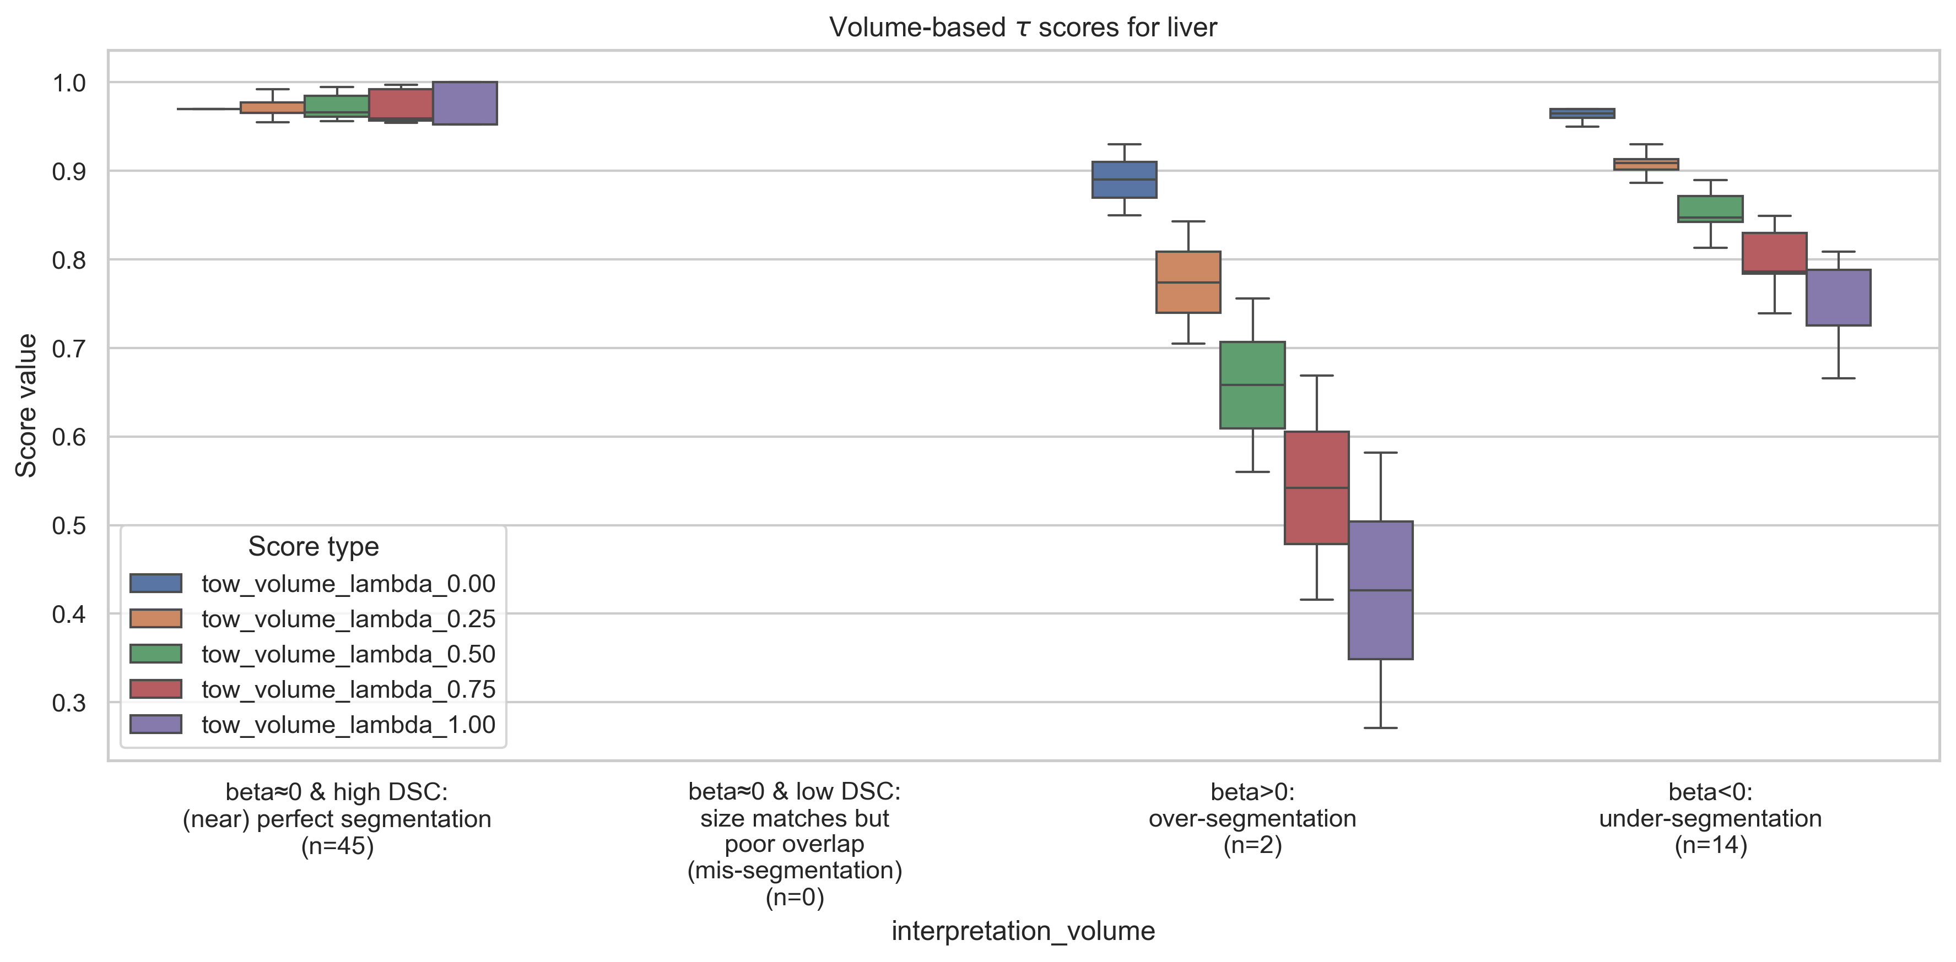
Proposed method ($β$ + $combined error E$) – with Quality of Segmentation Score $τ$
Liver (Easy – high DSC organ)
Error, $E = \sqrt{{\{λβ\}}^{2}+{\{\left(1−λ\right)(1−DSC)\}}^{2}} \text{∈ } \text{[0, 1]}$
Volume-based error score, $β=\frac{Volume \left(Pd\right)−Volume(GT)}{Volume(GT)}$
$${DSC}_{high}=80\%=0.80$$
|$β_{tolerance}|=2\%=0.02$
$$\&$$

Slide 19
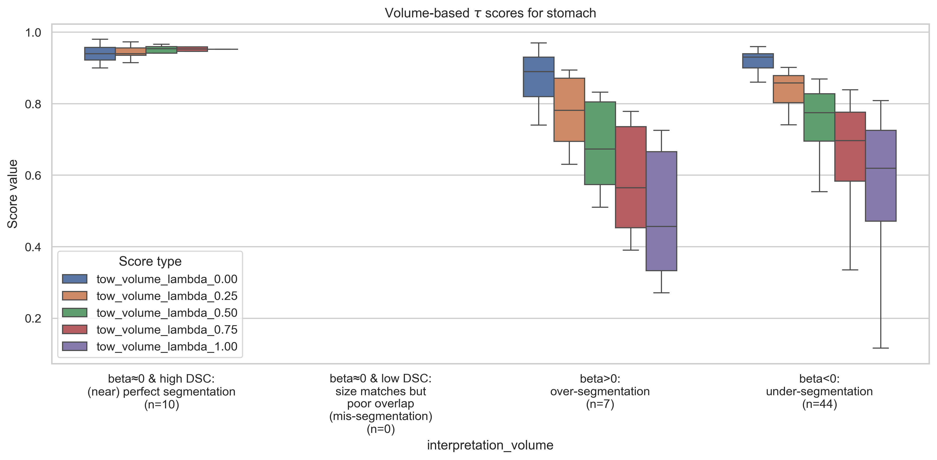
Proposed method ($β$ + $combined error E$) – with Quality of Segmentation Score $τ$
Stomach (Moderate – medium DSC organ)
Error, $E = \sqrt{{\{λβ\}}^{2}+{\{\left(1−λ\right)(1−DSC)\}}^{2}} \text{∈ } \text{[0, 1]}$
Volume-based error score, $β=\frac{Volume \left(Pd\right)−Volume(GT)}{Volume(GT)}$
$${DSC}_{high}=80\%=0.80$$
|$β_{tolerance}|=2\%=0.02$
$$\&$$

Slide 20
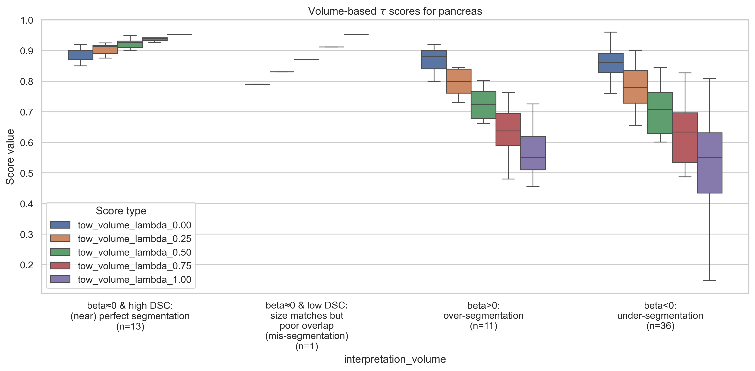
Proposed method ($β$ + $combined error E$) – with Quality of Segmentation Score $τ$
Pancreas (Difficult – low DSC organ)
Error, $E = \sqrt{{\{λβ\}}^{2}+{\{\left(1−λ\right)(1−DSC)\}}^{2}} \text{∈ } \text{[0, 1]}$
Volume-based error score, $β=\frac{Volume \left(Pd\right)−Volume(GT)}{Volume(GT)}$
$${DSC}_{high}=80\%=0.80$$
|$β_{tolerance}|=2\%=0.02$
$$\&$$

Slide 21
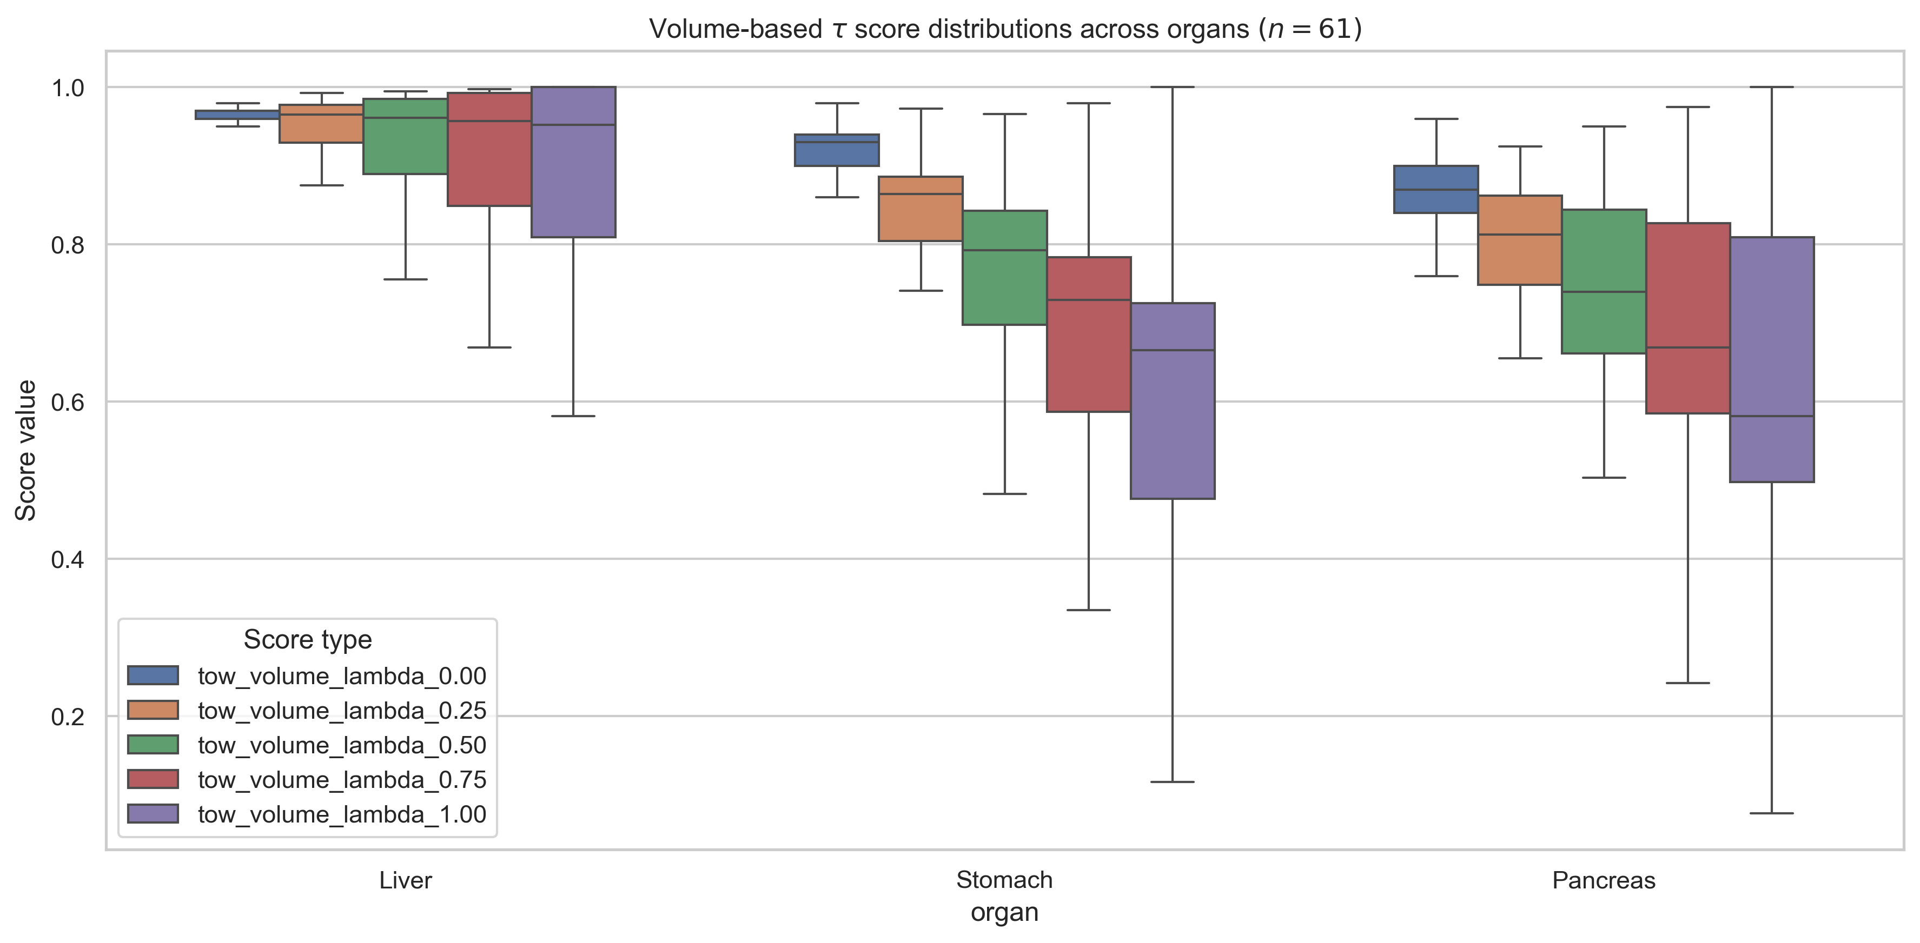
Proposed method ($β$ + $combined error E$) – with Quality of Segmentation Score $τ$
— Across organs
Across organs – Liver, Stomach, Pancreas
Error, $E = \sqrt{{\{λβ\}}^{2}+{\{\left(1−λ\right)(1−DSC)\}}^{2}} \text{∈ } \text{[0, 1]}$
Volume-based error score, $β=\frac{Volume \left(Pd\right)−Volume(GT)}{Volume(GT)}$
$${DSC}_{high}=80\%=0.80$$
|$β_{tolerance}|=2\%=0.02$
$$\&$$

Slide 22
Combined score, C
Combined score, $C=λ\frac{β+1}{2}+\left(1−λ\right)DSC$
Assumption: During over-segmentation, $Surface area (Pd)≤2×Surface area (GT)$
1. Difficult to interpret.
2. Loss of information.
3. Need a classifier/ more rule-based processing to draw meaningful segmentation error type categories from these combined C scores.
4. Highly dependent on the optimal selection of hyperparameter $λ$, $λ^{∗}$. And, optimal $λ^{∗}$ varies from dataset to dataset.
Volume-based error score, $β=\frac{Volume \left(Pd\right)−Volume(GT)}{Volume(GT)}$

Slide 23
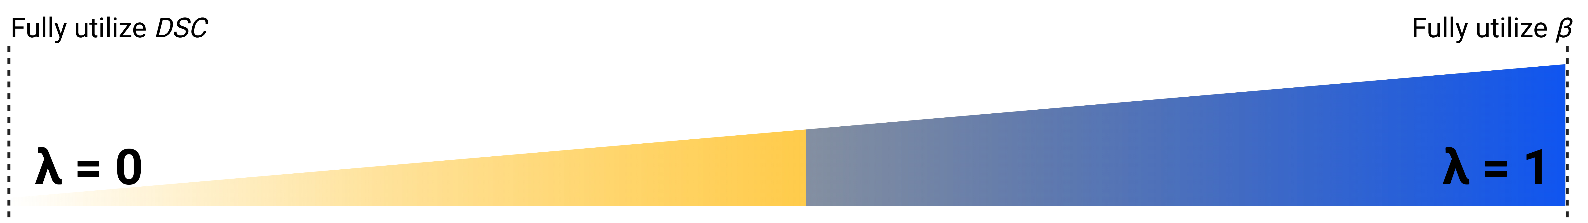
Results 2 – Statistical
R2c: $C$ scores across organs
Q1: How do $C$ scores perform across organs?
First, a sanity check:
1. When $λ=0$.00: We fully utilize $DSC$ ➔ $C=DSC$
2. When $λ=0.50$: We give 50% importance to $β$ and $DSC$ ➔ $C=\frac{DSC + {(β+1)}/2}{2}$
3. When $λ=1.00$: We fully utilize $β$ ➔ $C=\frac{β+1}{2}$

Slide 24
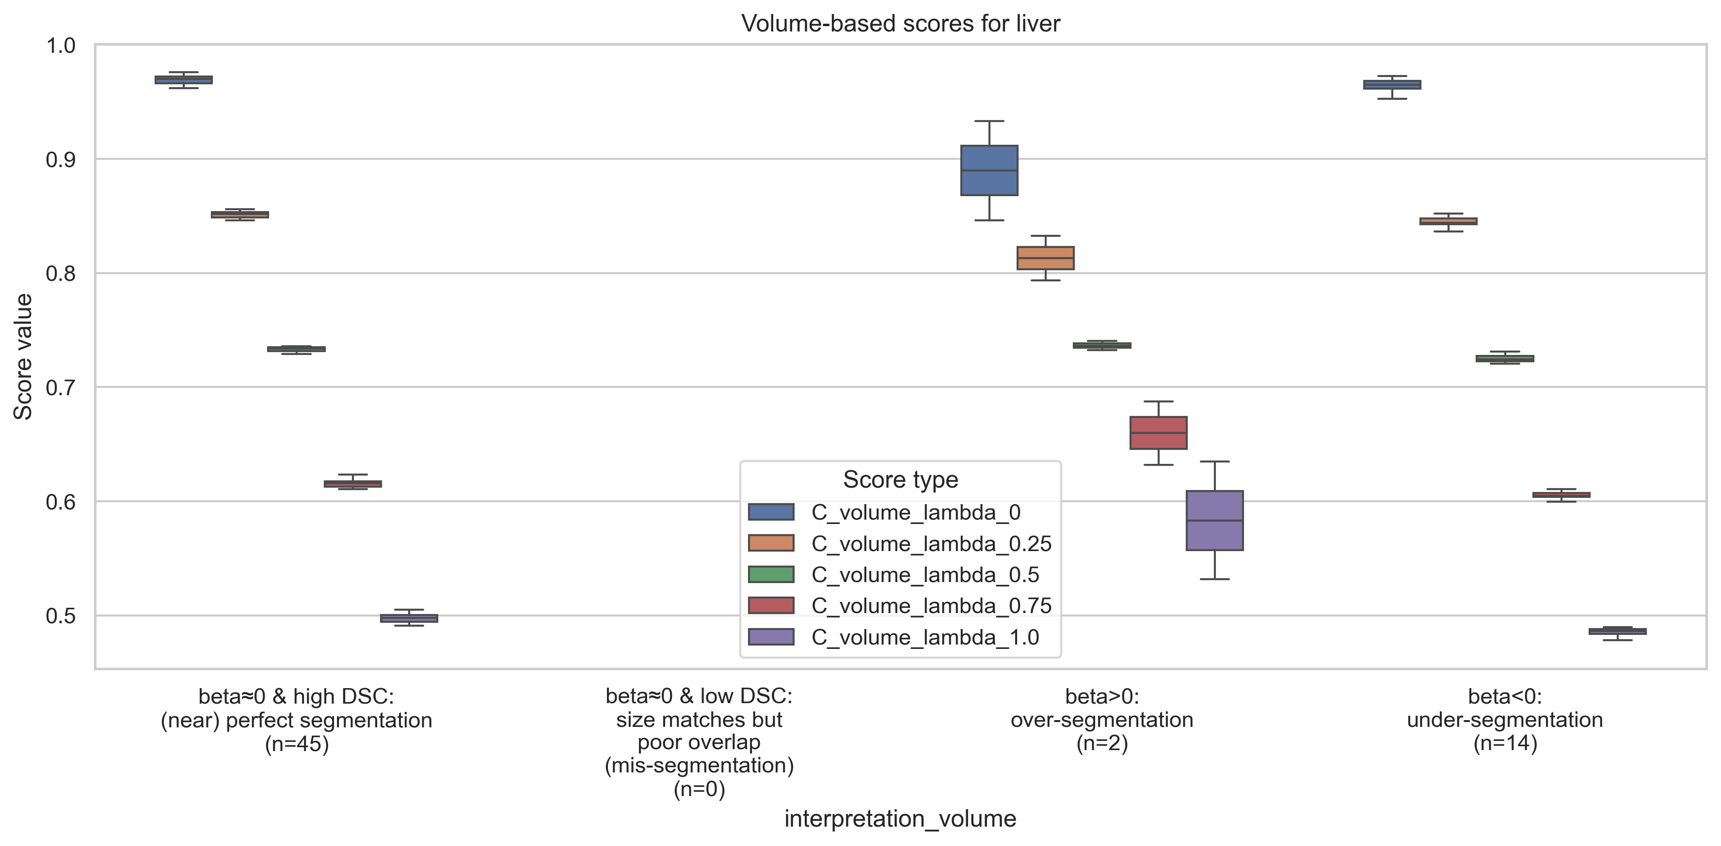
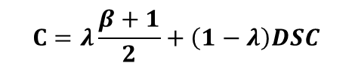
Combined $β−DSC$ score, $C$
Liver (Easy – high DSC organ)
$$C=λ\frac{β+1}{2}+\left(1−λ\right)DSC$$
Volume-based error score, $β=\frac{Volume \left(Pd\right)−Volume(GT)}{Volume(GT)}$
$${DSC}_{high}=80\%=0.80$$
|$β_{tolerance}|=2\%=0.02$
$$\&$$

Slide 25
Proposed method ($β$ + $combined error E$)
Liver (Easy – high DSC organ)
Error, $E = \sqrt{{\{λβ\}}^{2}+{\{\left(1−λ\right)(1−DSC)\}}^{2}} \text{∈ } \text{[0, 1]}$
Volume-based error score, $β=\frac{Volume \left(Pd\right)−Volume(GT)}{Volume(GT)}$
$${DSC}_{high}=80\%=0.80$$
|$β_{tolerance}|=2\%=0.02$
$$\&$$

Slide 26
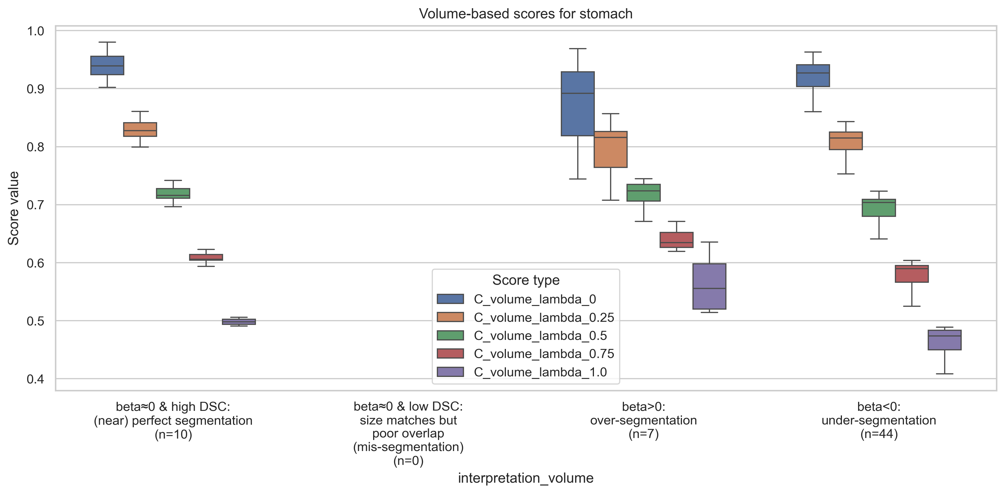
Combined $β−DSC$ score, $C$
Stomach (Moderate – medium DSC organ)
$$C=λ\frac{β+1}{2}+\left(1−λ\right)DSC$$
Volume-based error score, $β=\frac{Volume \left(Pd\right)−Volume(GT)}{Volume(GT)}$
$${DSC}_{high}=80\%=0.80$$
|$β_{tolerance}|=2\%=0.02$
$$\&$$

Slide 27
Proposed method ($β$ + $combined error E$)
Stomach (Moderate – medium DSC organ)
Error, $E = \sqrt{{\{λβ\}}^{2}+{\{\left(1−λ\right)(1−DSC)\}}^{2}} \text{∈ } \text{[0, 1]}$
Volume-based error score, $β=\frac{Volume \left(Pd\right)−Volume(GT)}{Volume(GT)}$
$${DSC}_{high}=80\%=0.80$$
|$β_{tolerance}|=2\%=0.02$
$$\&$$

Slide 28
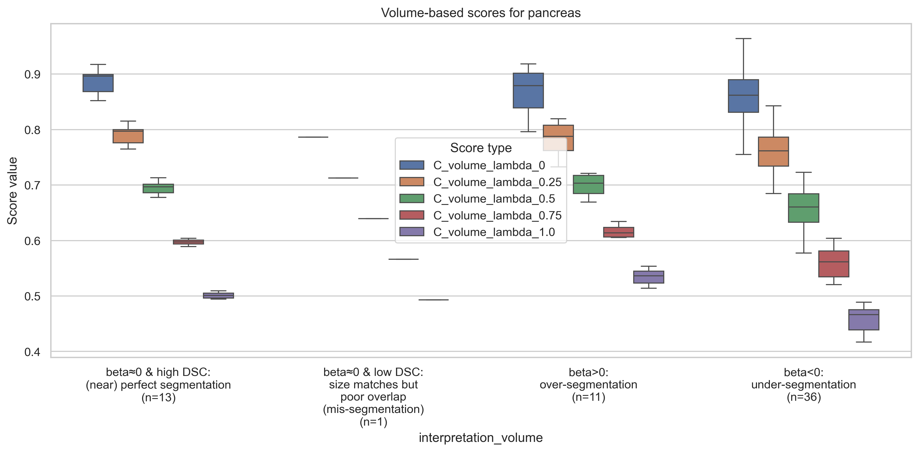
Combined $β−DSC$ score, $C$
Pancreas (Difficult – low DSC organ)
$$C=λ\frac{β+1}{2}+\left(1−λ\right)DSC$$
Volume-based error score, $β=\frac{Volume \left(Pd\right)−Volume(GT)}{Volume(GT)}$
$${DSC}_{high}=80\%=0.80$$
|$β_{tolerance}|=2\%=0.02$
$$\&$$

Slide 29
Proposed method ($β$ + $combined error E$)
Pancreas (Difficult – low DSC organ)
Error, $E = \sqrt{{\{λβ\}}^{2}+{\{\left(1−λ\right)(1−DSC)\}}^{2}} \text{∈ } \text{[0, 1]}$
Volume-based error score, $β=\frac{Volume \left(Pd\right)−Volume(GT)}{Volume(GT)}$
$${DSC}_{high}=80\%=0.80$$
|$β_{tolerance}|=2\%=0.02$
$$\&$$

Slide 30
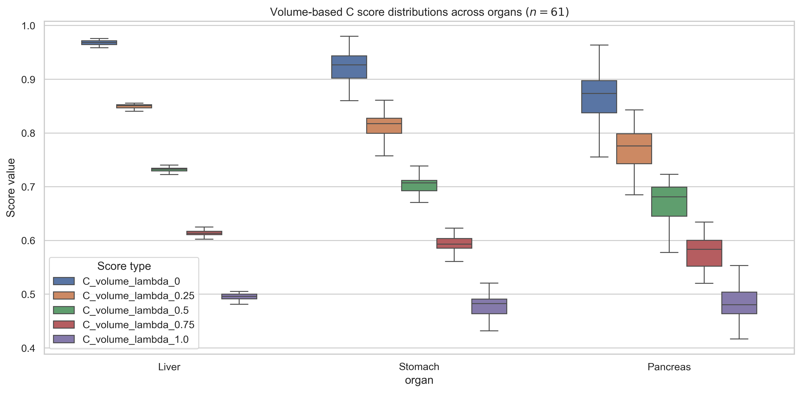
Combined $β−DSC$ score, $C$
— Across organs
Across organs – Liver, Stomach, Pancreas
$$C=λ\frac{β+1}{2}+\left(1−λ\right)DSC$$
Volume-based error score, $β=\frac{Volume \left(Pd\right)−Volume(GT)}{Volume(GT)}$
$${DSC}_{high}=80\%=0.80$$
|$β_{tolerance}|=2\%=0.02$
$$\&$$

Slide 31
Proposed method ($β$ + $combined error E$)
— Across organs
Across organs – Liver, Stomach, Pancreas
Error, $E = \sqrt{{\{λβ\}}^{2}+{\{\left(1−λ\right)(1−DSC)\}}^{2}} \text{∈ } \text{[0, 1]}$
Volume-based error score, $β=\frac{Volume \left(Pd\right)−Volume(GT)}{Volume(GT)}$
$${DSC}_{high}=80\%=0.80$$
|$β_{tolerance}|=2\%=0.02$
$$\&$$

Slide 32
Should we use volume- or SA-based scores?
Should we use volume- or SA-based scores?
It depends on what we are more interested in.
I do not think there is a right or wrong answer, based on the results – they are just two different metrics.
➔ Next: Side-by-side comparisons of volume- and SA-based scores
$${DSC}_{high}=80\%=0.80$$
|$β_{tolerance}|=2\%=0.02$
$$\&$$

Slide 33
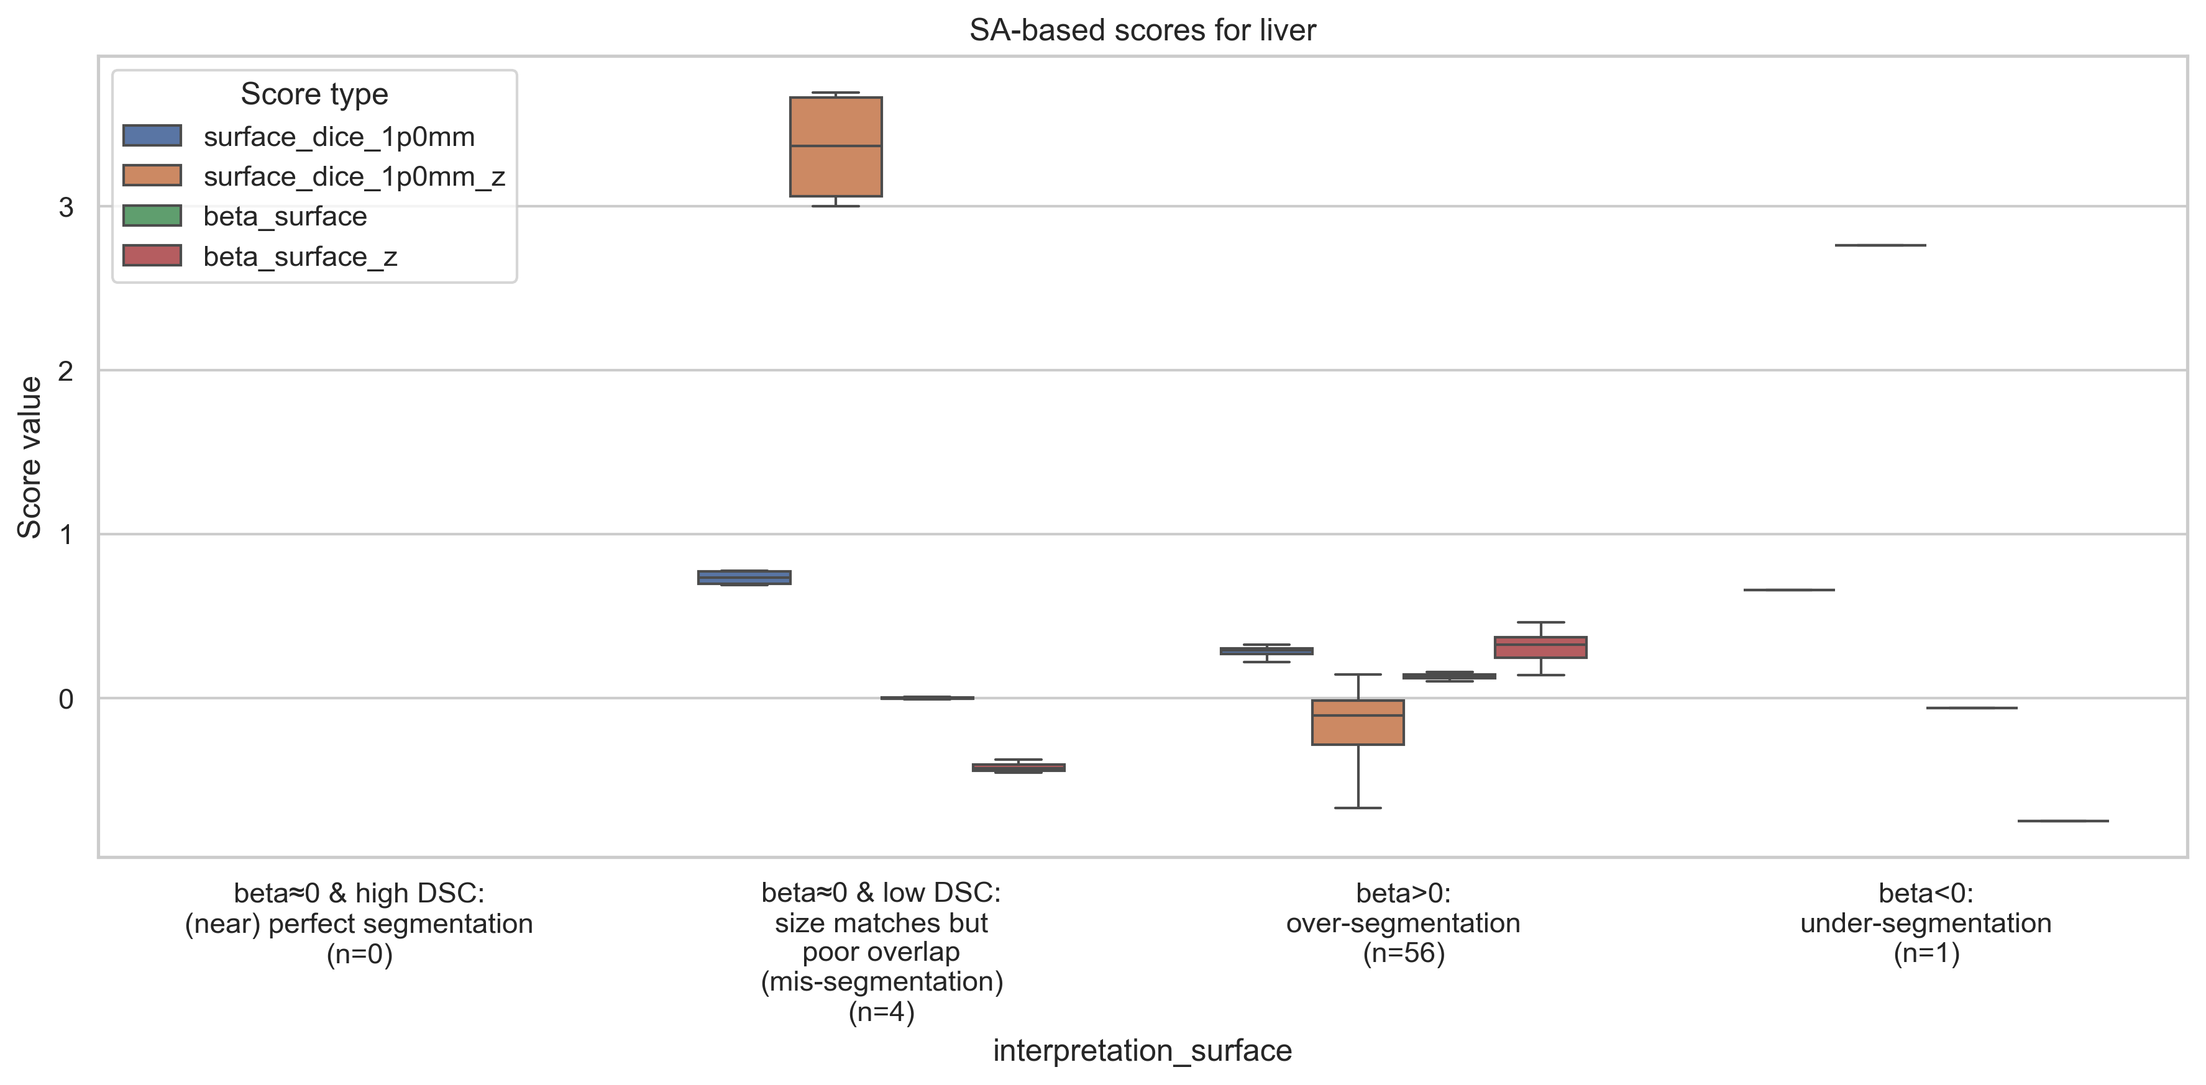
What do these error categories actually look like?
Liver (Easy – high DSC organ)
$${DSC}_{high}=80\%=0.80$$
|$β_{tolerance}|=2\%=0.02$
$$\&$$

Slide 34
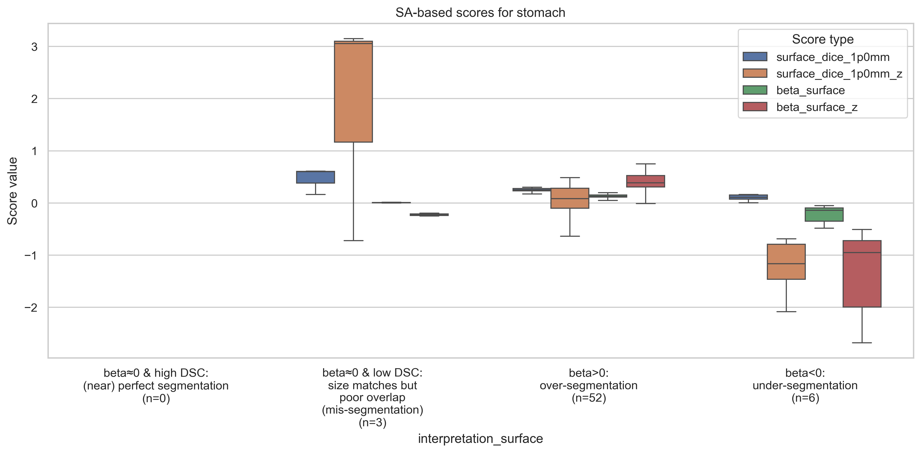
What do these error categories actually look like? (2)
Stomach (Moderate – medium DSC organ)
$${DSC}_{high}=80\%=0.80$$
|$β_{tolerance}|=2\%=0.02$
$$\&$$

Slide 35
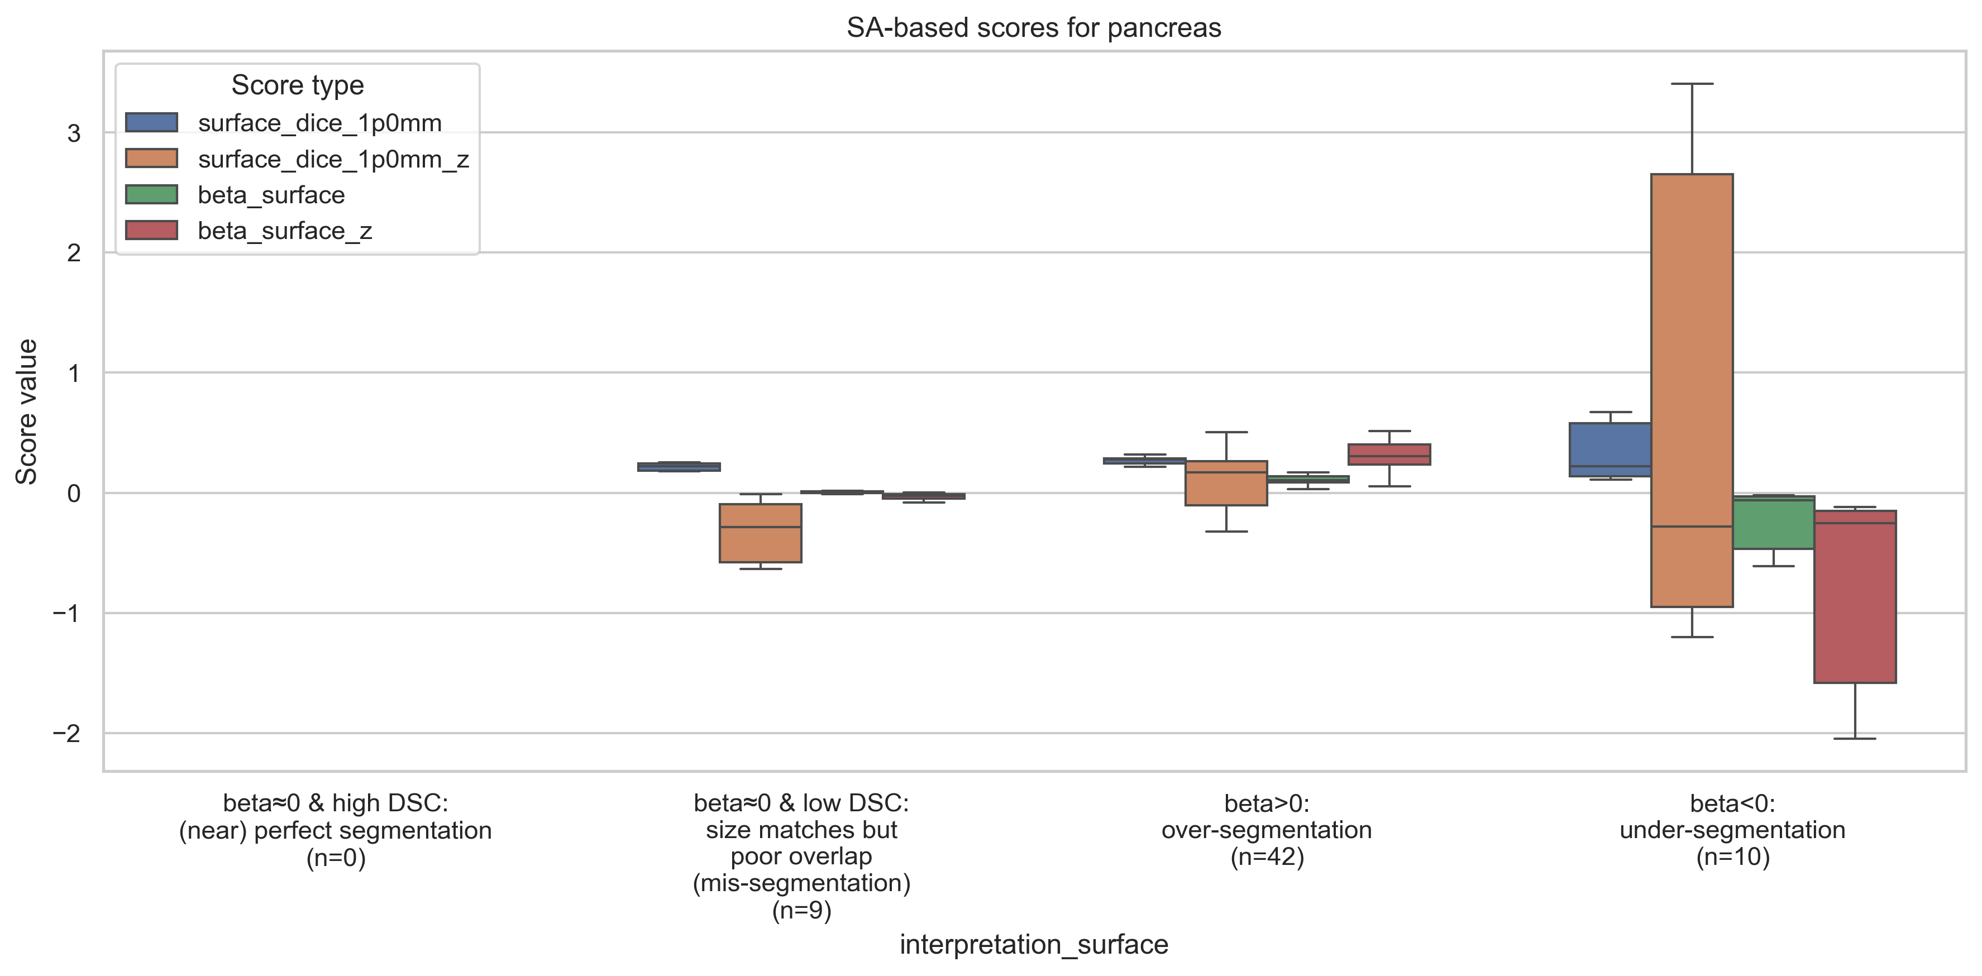
What do these error categories actually look like? (3)
Pancreas (Difficult – low DSC organ)
$${DSC}_{high}=80\%=0.80$$
|$β_{tolerance}|=2\%=0.02$
$$\&$$

Slide 36
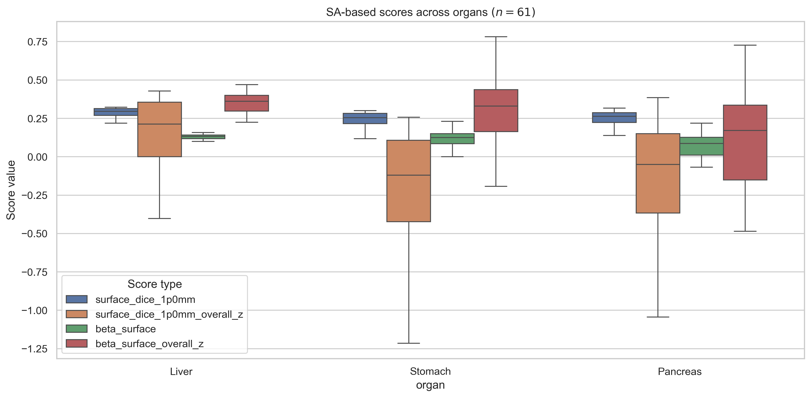
What insights can we draw from across organs?
– And, how removing “mis-segmentation” samples helps?
Across organs – Liver, Stomach, Pancreas
$${DSC}_{high}=80\%=0.80$$
|$β_{tolerance}|=2\%=0.02$
$$\&$$

Slide 37
Proposed method ($β$ + $combined error E$)
Error, $E = \sqrt{{\{λβ\}}^{2}+{\{\left(1−λ\right)(1−DSC)\}}^{2}} \text{∈ } \text{[0, 1]}$
Assumption: During over-segmentation, $Area or Volume \left(Pd\right)≤2×Area or Volume (GT)$

Slide 38
Proposed method ($β$ + $combined error E$)
Liver (Easy – high DSC organ) → Volume-based $β$, $DSC$, $E$
Error, $E = \sqrt{{\{λβ\}}^{2}+{\{\left(1−λ\right)(1−DSC)\}}^{2}} \text{∈ } \text{[0, 1]}$
$${DSC}_{high}=80\%=0.80$$
|$β_{tolerance}|=2\%=0.02$
$$\&$$

Slide 39
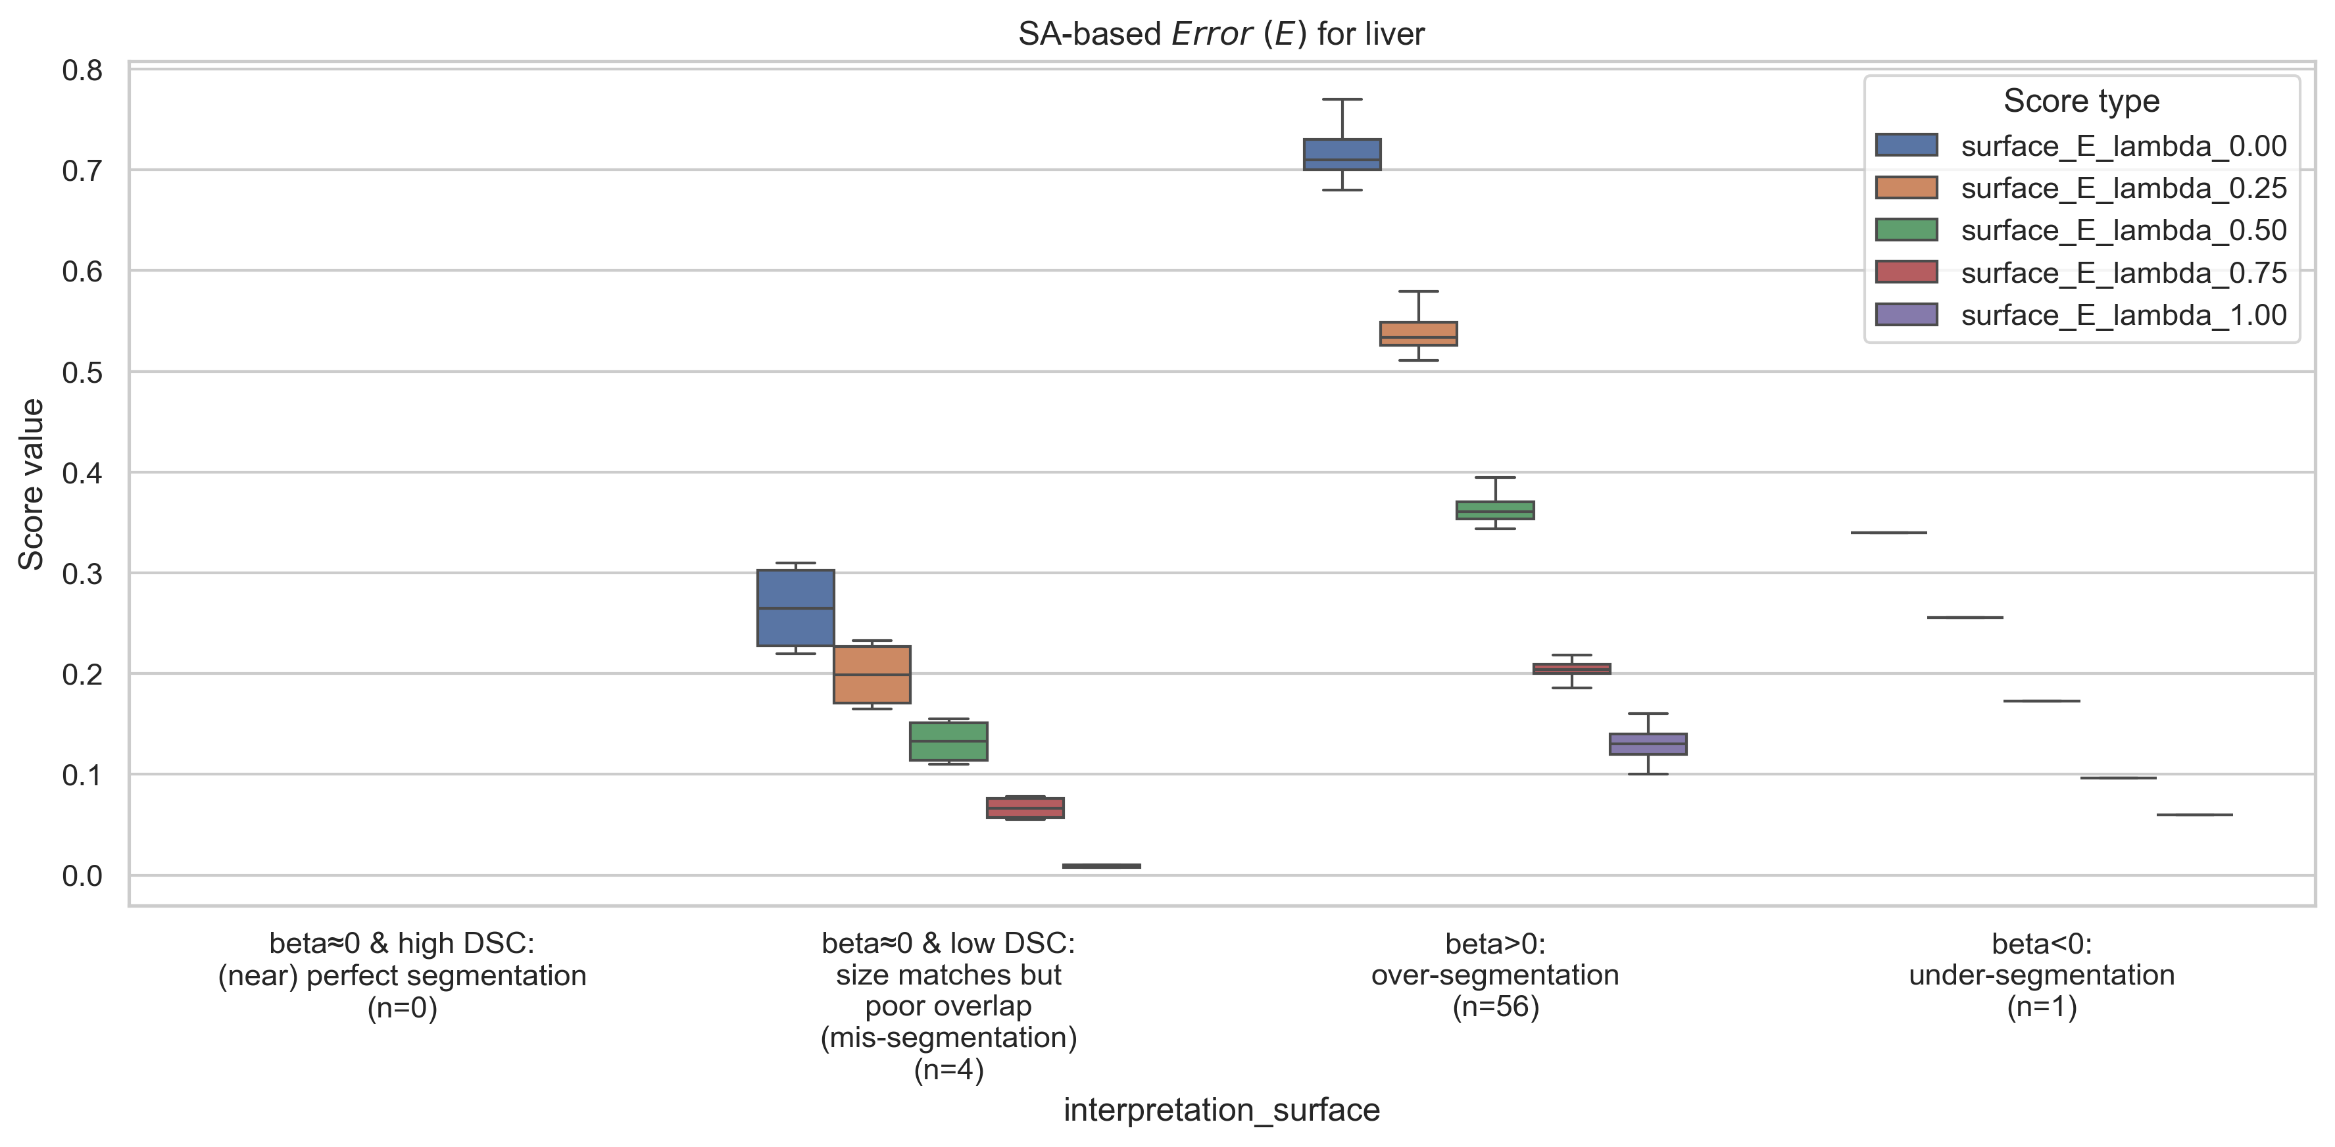
Proposed method ($β$ + $combined error E$)
Liver (Easy – high DSC organ) → SA-based $β$, $DSC$, $E$
Error, $E = \sqrt{{\{λβ\}}^{2}+{\{\left(1−λ\right)(1−DSC)\}}^{2}} \text{∈ } \text{[0, 1]}$
$${DSC}_{high}=80\%=0.80$$
|$β_{tolerance}|=2\%=0.02$
$$\&$$

Slide 40
Proposed method ($β$ + $combined error E$)
Stomach (Moderate – medium DSC organ) → Volume-based $β$, $DSC$, $E$
Error, $E = \sqrt{{\{λβ\}}^{2}+{\{\left(1−λ\right)(1−DSC)\}}^{2}} \text{∈ } \text{[0, 1]}$
$${DSC}_{high}=80\%=0.80$$
|$β_{tolerance}|=2\%=0.02$
$$\&$$

Slide 41
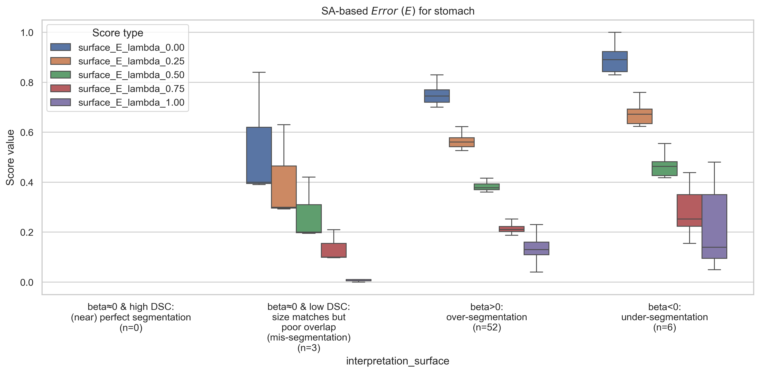
Proposed method ($β$ + $combined error E$)
Stomach (Moderate – medium DSC organ) → SA-based $β$, $DSC$, $E$
Error, $E = \sqrt{{\{λβ\}}^{2}+{\{\left(1−λ\right)(1−DSC)\}}^{2}} \text{∈ } \text{[0, 1]}$
$${DSC}_{high}=80\%=0.80$$
|$β_{tolerance}|=2\%=0.02$
$$\&$$

Slide 42
Proposed method ($β$ + $combined error E$)
Pancreas (Difficult – low DSC organ) → Volume-based $β$, $DSC$, $E$
Error, $E = \sqrt{{\{λβ\}}^{2}+{\{\left(1−λ\right)(1−DSC)\}}^{2}} \text{∈ } \text{[0, 1]}$
$${DSC}_{high}=80\%=0.80$$
|$β_{tolerance}|=2\%=0.02$
$$\&$$

Slide 43
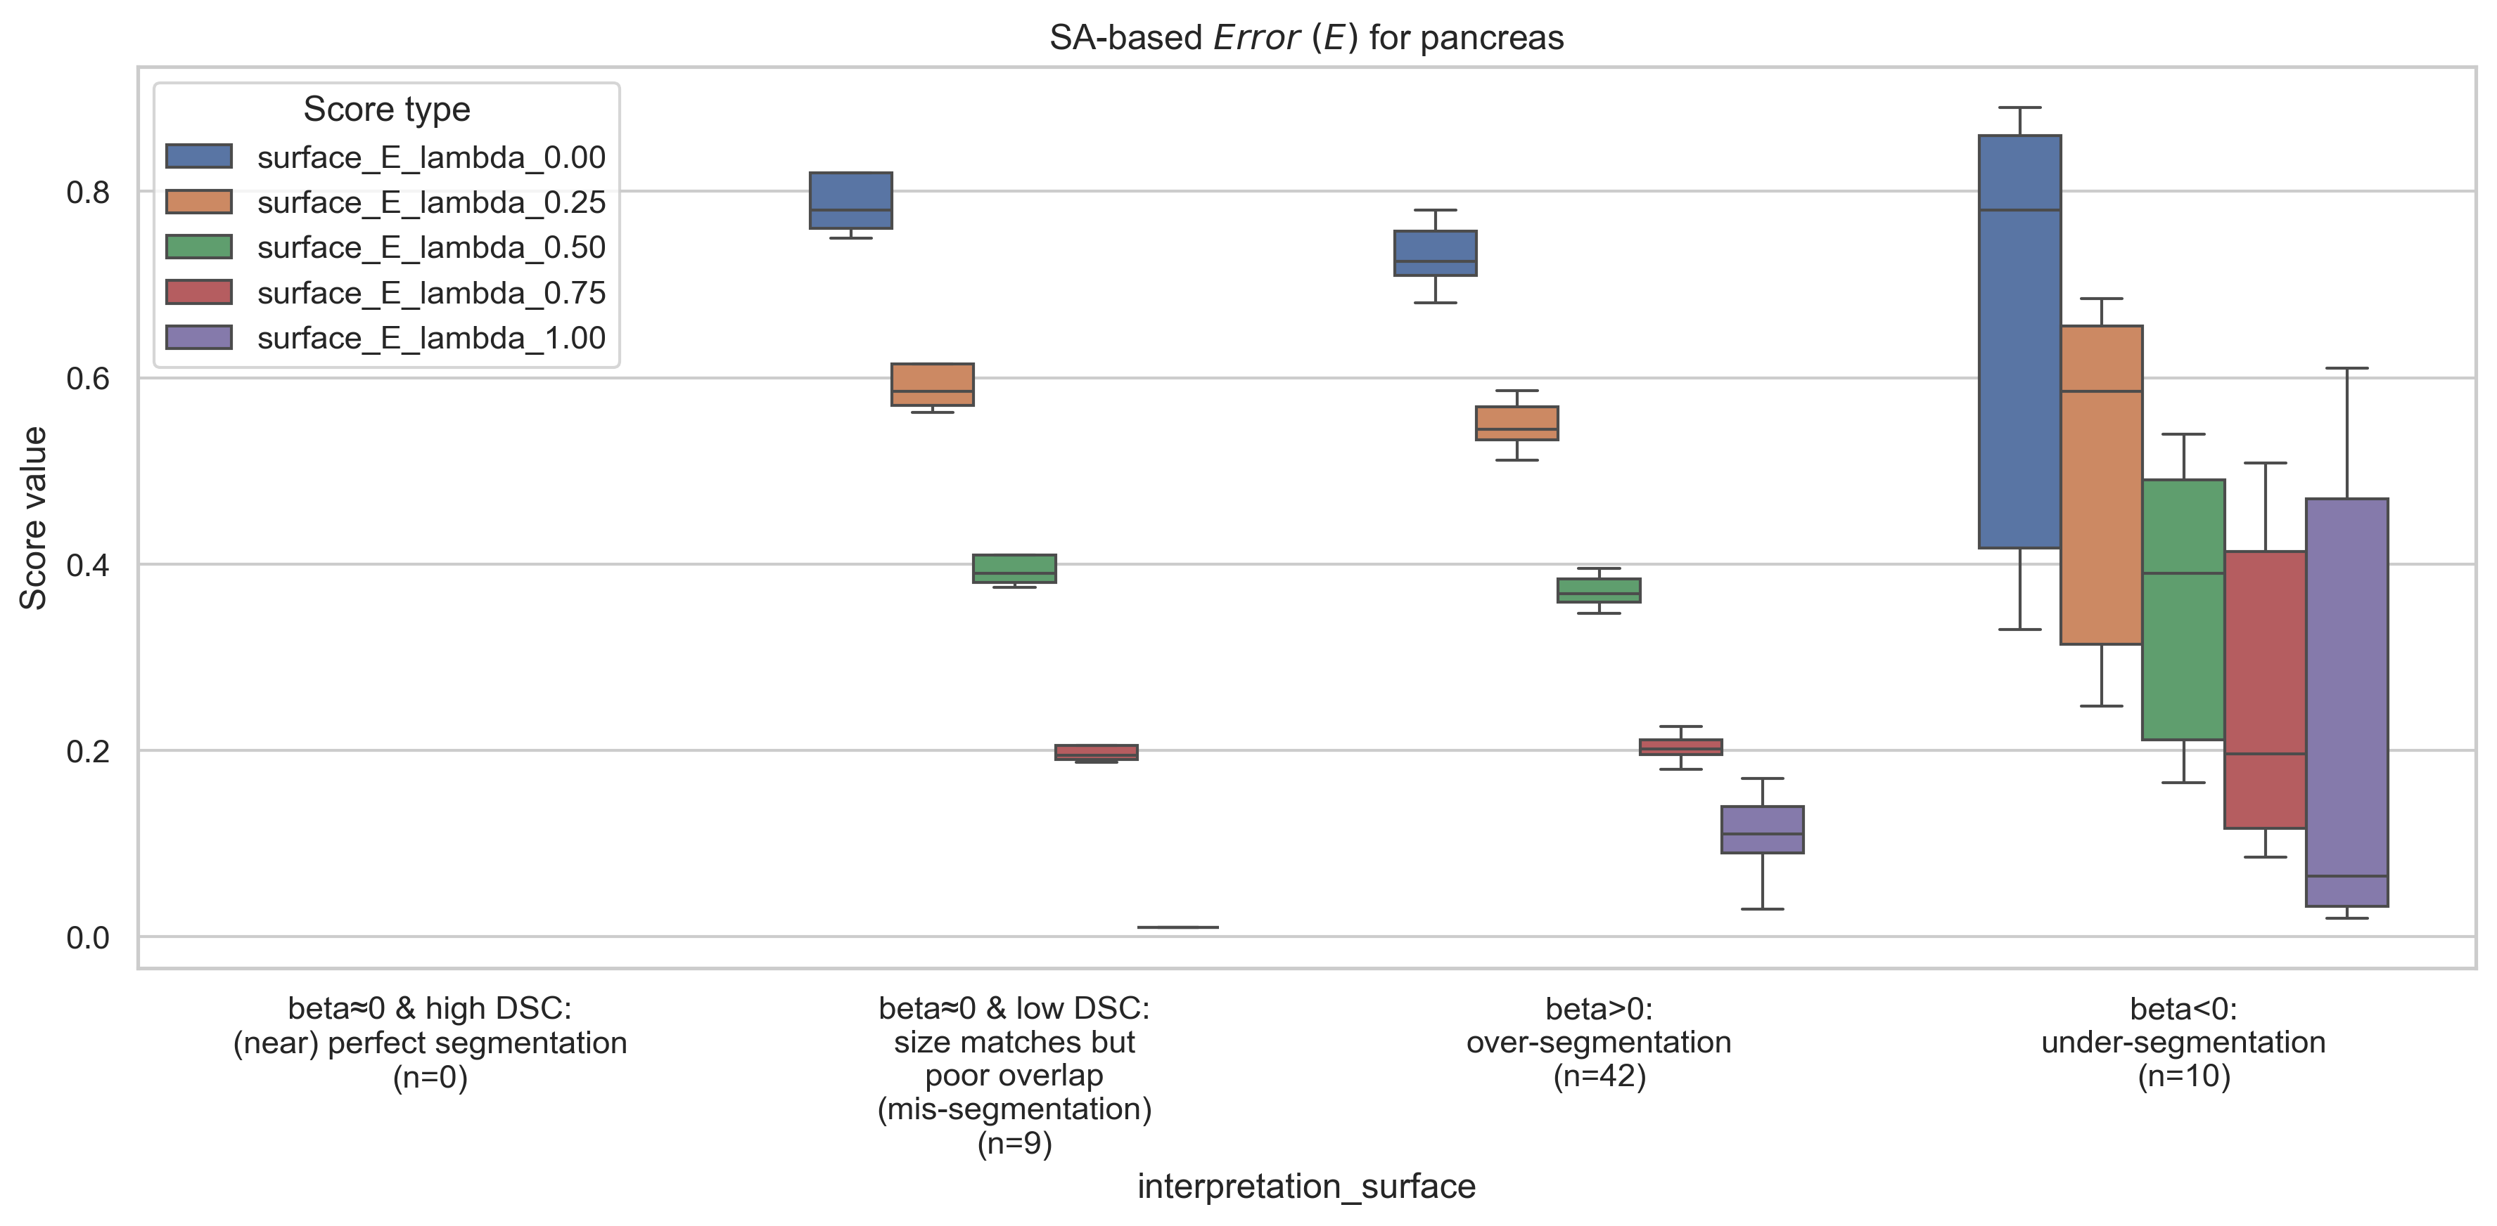
Proposed method ($β$ + $combined error E$)
Pancreas (Difficult – low DSC organ) → SA-based $β$, $DSC$, $E$
Error, $E = \sqrt{{\{λβ\}}^{2}+{\{\left(1−λ\right)(1−DSC)\}}^{2}} \text{∈ } \text{[0, 1]}$
$${DSC}_{high}=80\%=0.80$$
|$β_{tolerance}|=2\%=0.02$
$$\&$$

Slide 44
Proposed method ($β$ + $combined error E$)
— Across organs
Across organs – Liver, Stomach, Pancreas → Volume-based $β$, $DSC$, $E$
Error, $E = \sqrt{{\{λβ\}}^{2}+{\{\left(1−λ\right)(1−DSC)\}}^{2}} \text{∈ } \text{[0, 1]}$
$${DSC}_{high}=80\%=0.80$$
|$β_{tolerance}|=2\%=0.02$
$$\&$$

Slide 45
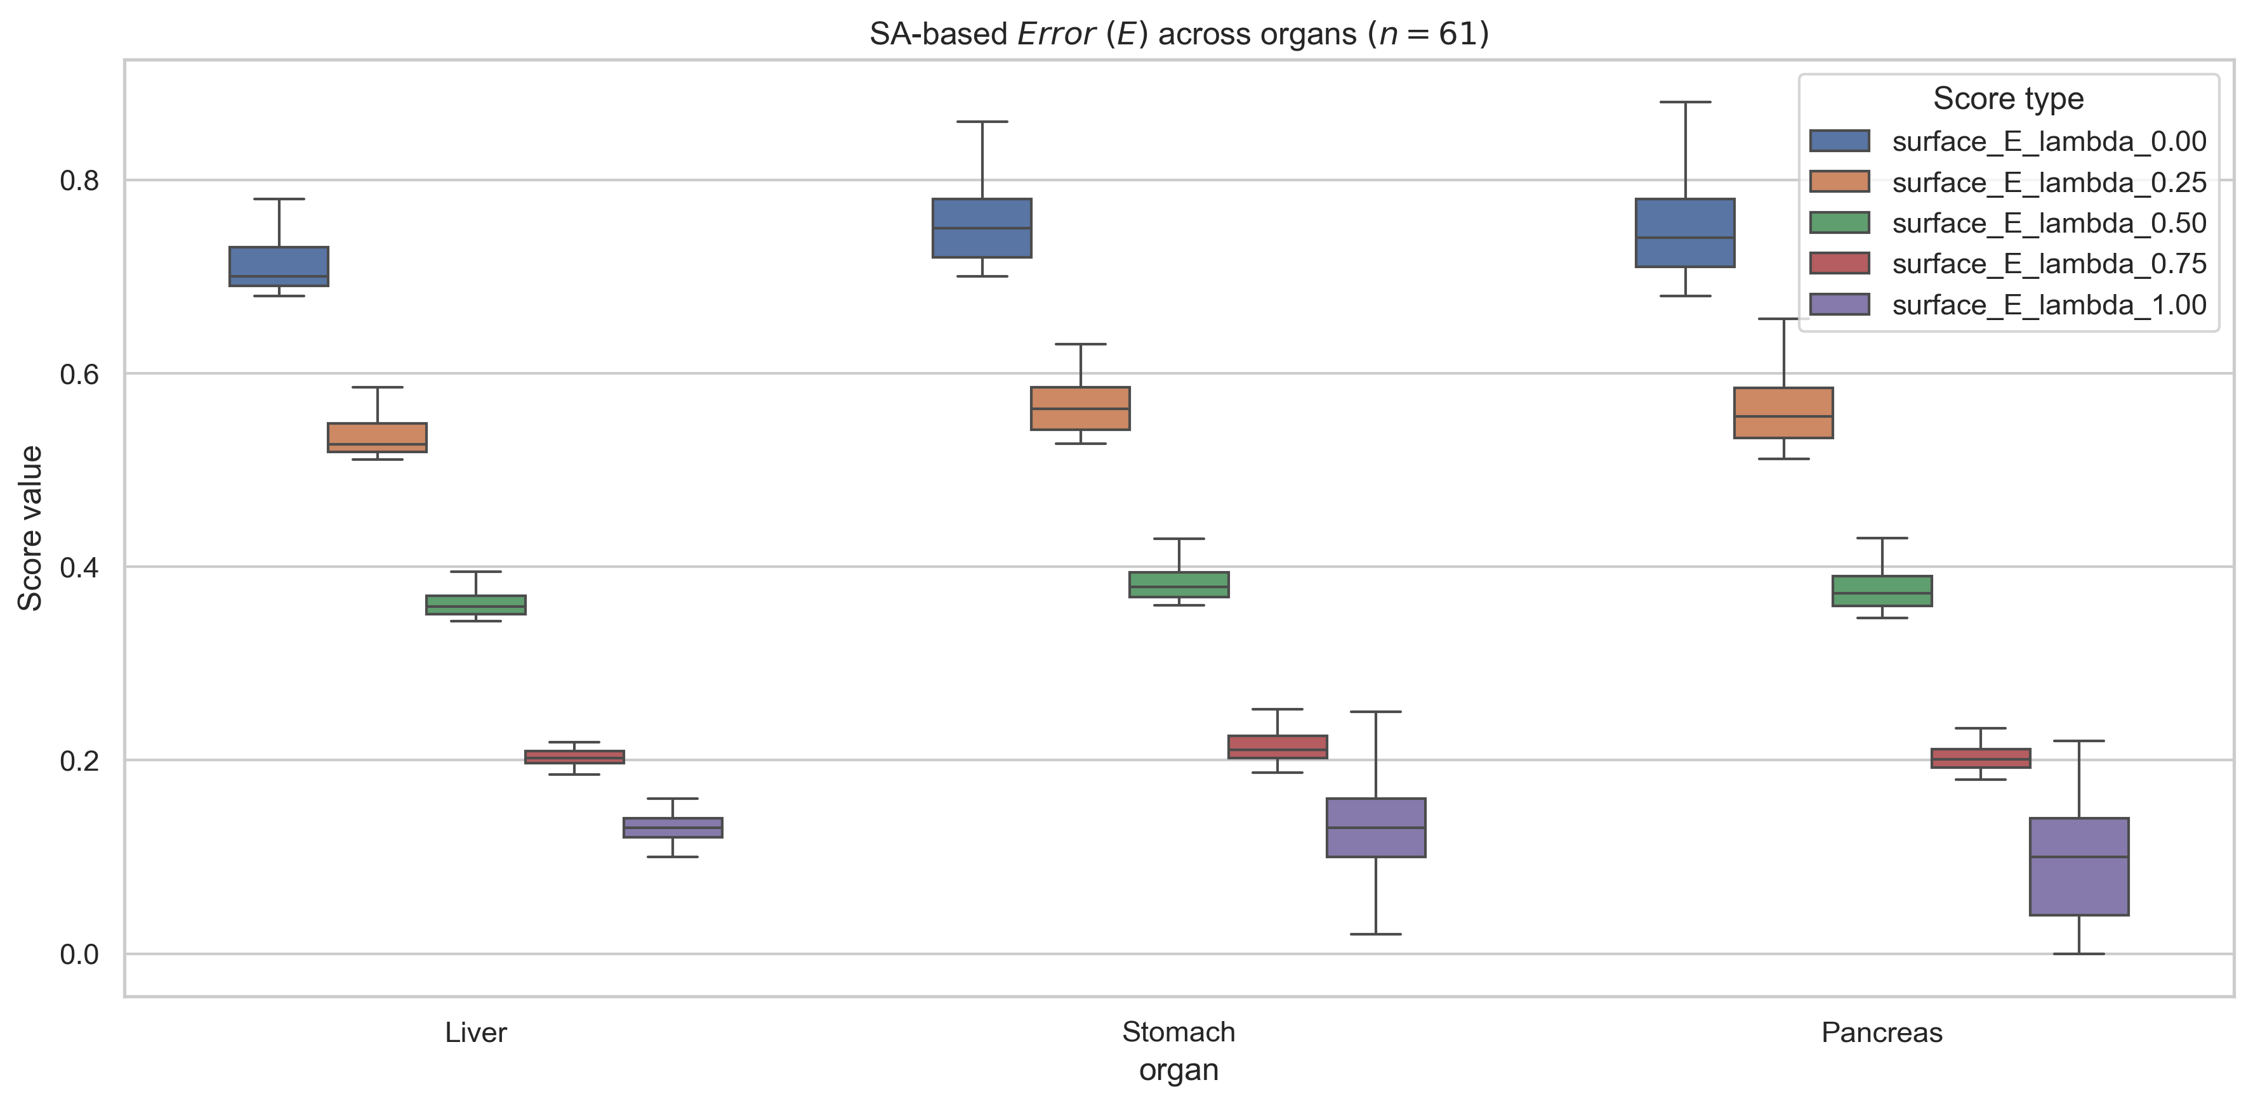
Proposed method ($β$ + $combined error E$)
— Across organs
Across organs – Liver, Stomach, Pancreas → SA-based $β$, $DSC$, $E$
Error, $E = \sqrt{{\{λβ\}}^{2}+{\{\left(1−λ\right)(1−DSC)\}}^{2}} \text{∈ } \text{[0, 1]}$
$${DSC}_{high}=80\%=0.80$$
|$β_{tolerance}|=2\%=0.02$
$$\&$$

Slide 46
Proposed method ($β$ + $combined error E$) – with Quality of Segmentation Score $τ$
Segmentation Quality Score, $τ ∀ β_{r2}ε\{\frac{β}{100}|βεℤ\}$:
$τ=λ+\left(1−λ\right)DSC$, if $β_{r2}=0$
$τ=λ\frac{\log_{10}\frac{1}{|β|}}{2.1}+\left(1−λ\right)DSC$, if $β_{r2}≠0$
Assumption: During over-segmentation, $Area or Volume \left(Pd\right)≤2×Area or Volume (GT)$

Slide 47
Proposed method ($β$ + $combined error E$) – with Quality of Segmentation Score $τ$
Liver (Easy – high DSC organ) → Volume-based $β$, $DSC$, $E$
Error, $E = \sqrt{{\{λβ\}}^{2}+{\{\left(1−λ\right)(1−DSC)\}}^{2}} \text{∈ } \text{[0, 1]}$
$${DSC}_{high}=80\%=0.80$$
|$β_{tolerance}|=2\%=0.02$
$$\&$$

Slide 48
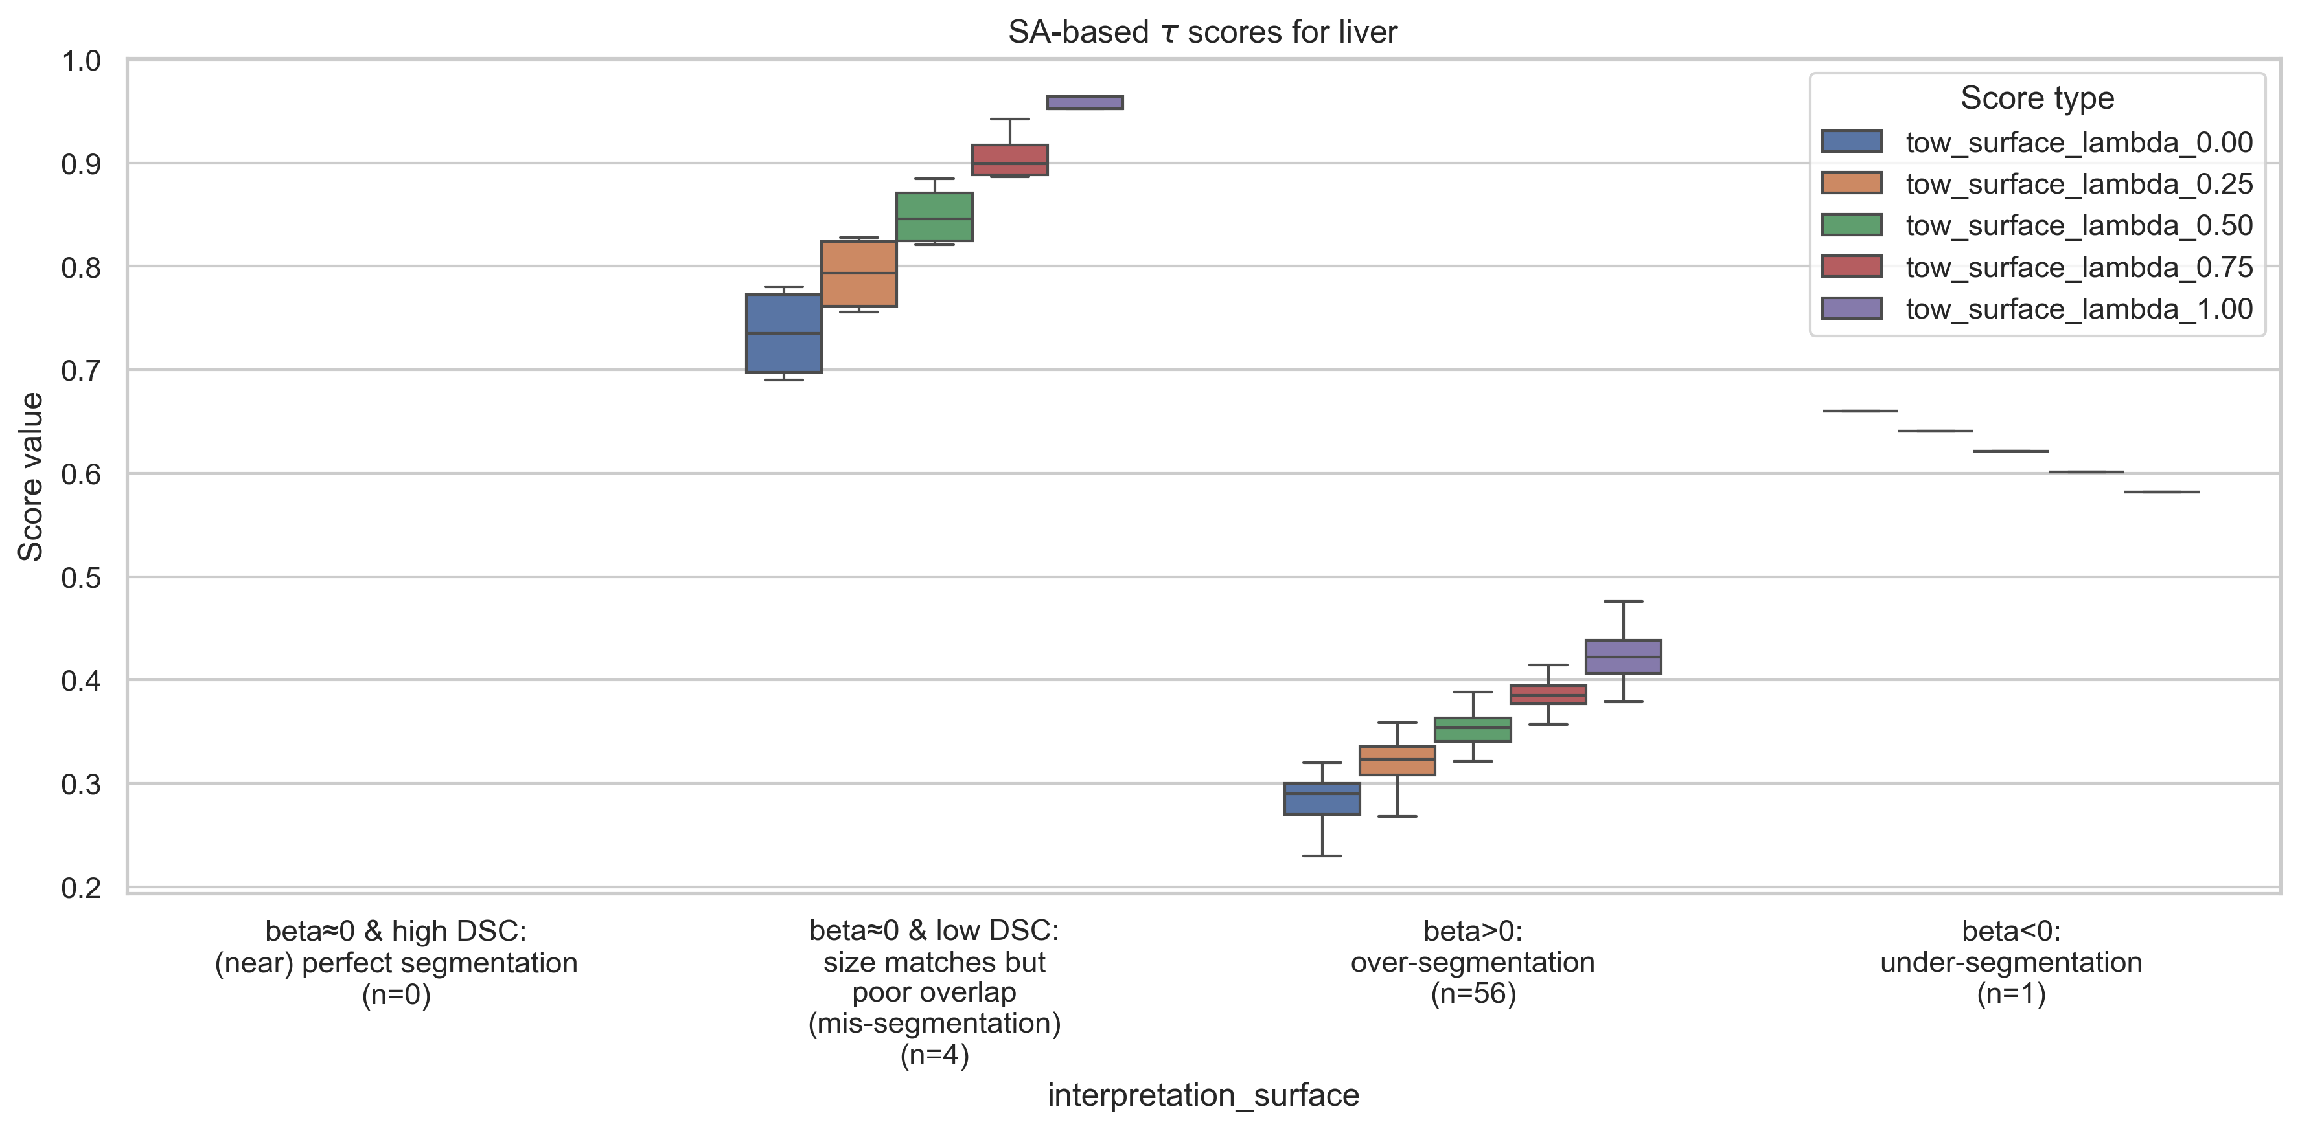
Proposed method ($β$ + $combined error E$) – with Quality of Segmentation Score $τ$
Liver (Easy – high DSC organ) → SA-based $β$, $DSC$, $E$
Error, $E = \sqrt{{\{λβ\}}^{2}+{\{\left(1−λ\right)(1−DSC)\}}^{2}} \text{∈ } \text{[0, 1]}$
$${DSC}_{high}=80\%=0.80$$
|$β_{tolerance}|=2\%=0.02$
$$\&$$

Slide 49
Proposed method ($β$ + $combined error E$) – with Quality of Segmentation Score $τ$
Stomach (Moderate – medium DSC organ) → Volume-based $β$, $DSC$, $E$
Error, $E = \sqrt{{\{λβ\}}^{2}+{\{\left(1−λ\right)(1−DSC)\}}^{2}} \text{∈ } \text{[0, 1]}$
$${DSC}_{high}=80\%=0.80$$
|$β_{tolerance}|=2\%=0.02$
$$\&$$

Slide 50
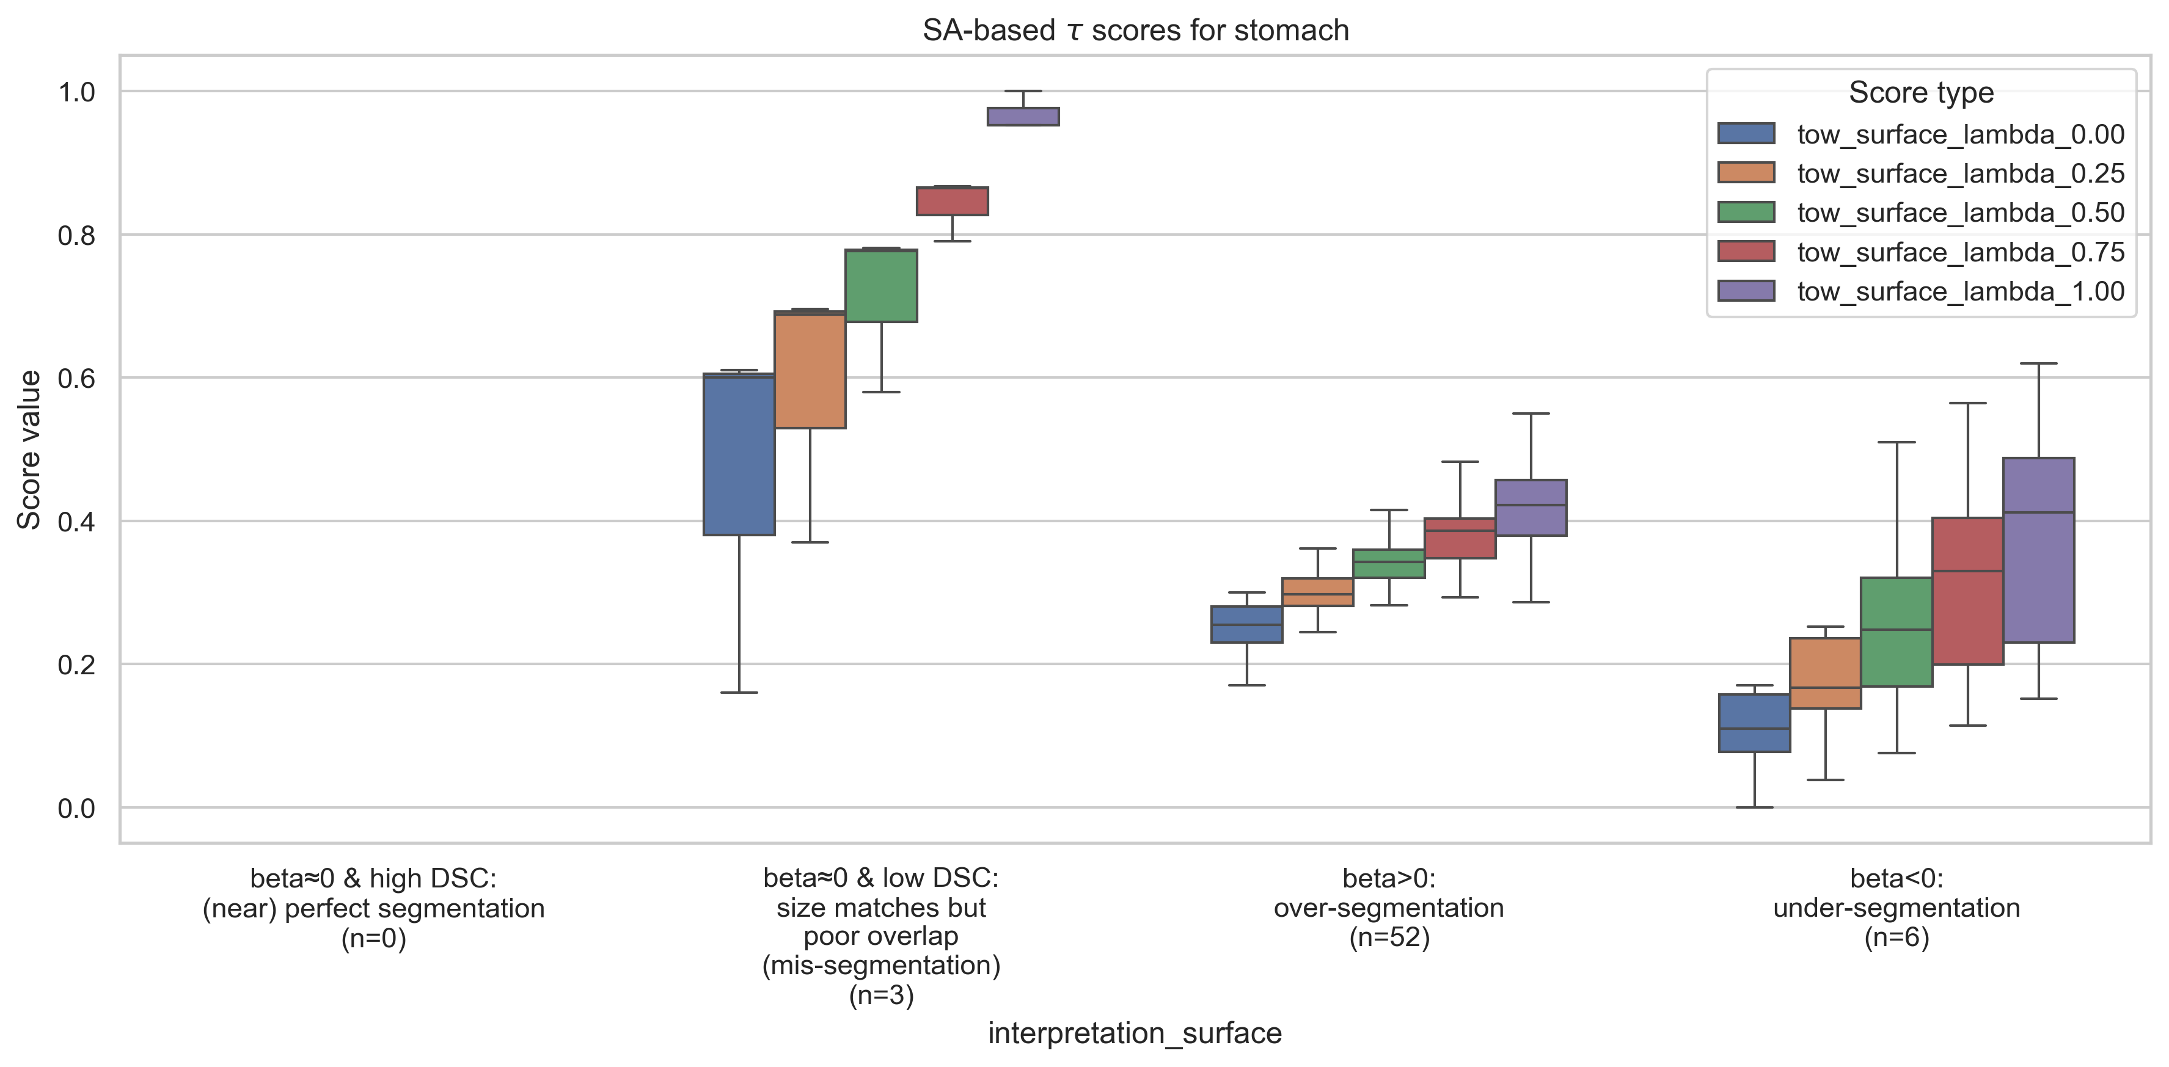
Proposed method ($β$ + $combined error E$) – with Quality of Segmentation Score $τ$
Stomach (Moderate – medium DSC organ) → SA-based $β$, $DSC$, $E$
Error, $E = \sqrt{{\{λβ\}}^{2}+{\{\left(1−λ\right)(1−DSC)\}}^{2}} \text{∈ } \text{[0, 1]}$
$${DSC}_{high}=80\%=0.80$$
|$β_{tolerance}|=2\%=0.02$
$$\&$$

Slide 51
Proposed method ($β$ + $combined error E$) – with Quality of Segmentation Score $τ$
Pancreas (Difficult – low DSC organ) → Volume-based $β$, $DSC$, $E$
Error, $E = \sqrt{{\{λβ\}}^{2}+{\{\left(1−λ\right)(1−DSC)\}}^{2}} \text{∈ } \text{[0, 1]}$
$${DSC}_{high}=80\%=0.80$$
|$β_{tolerance}|=2\%=0.02$
$$\&$$

Slide 52
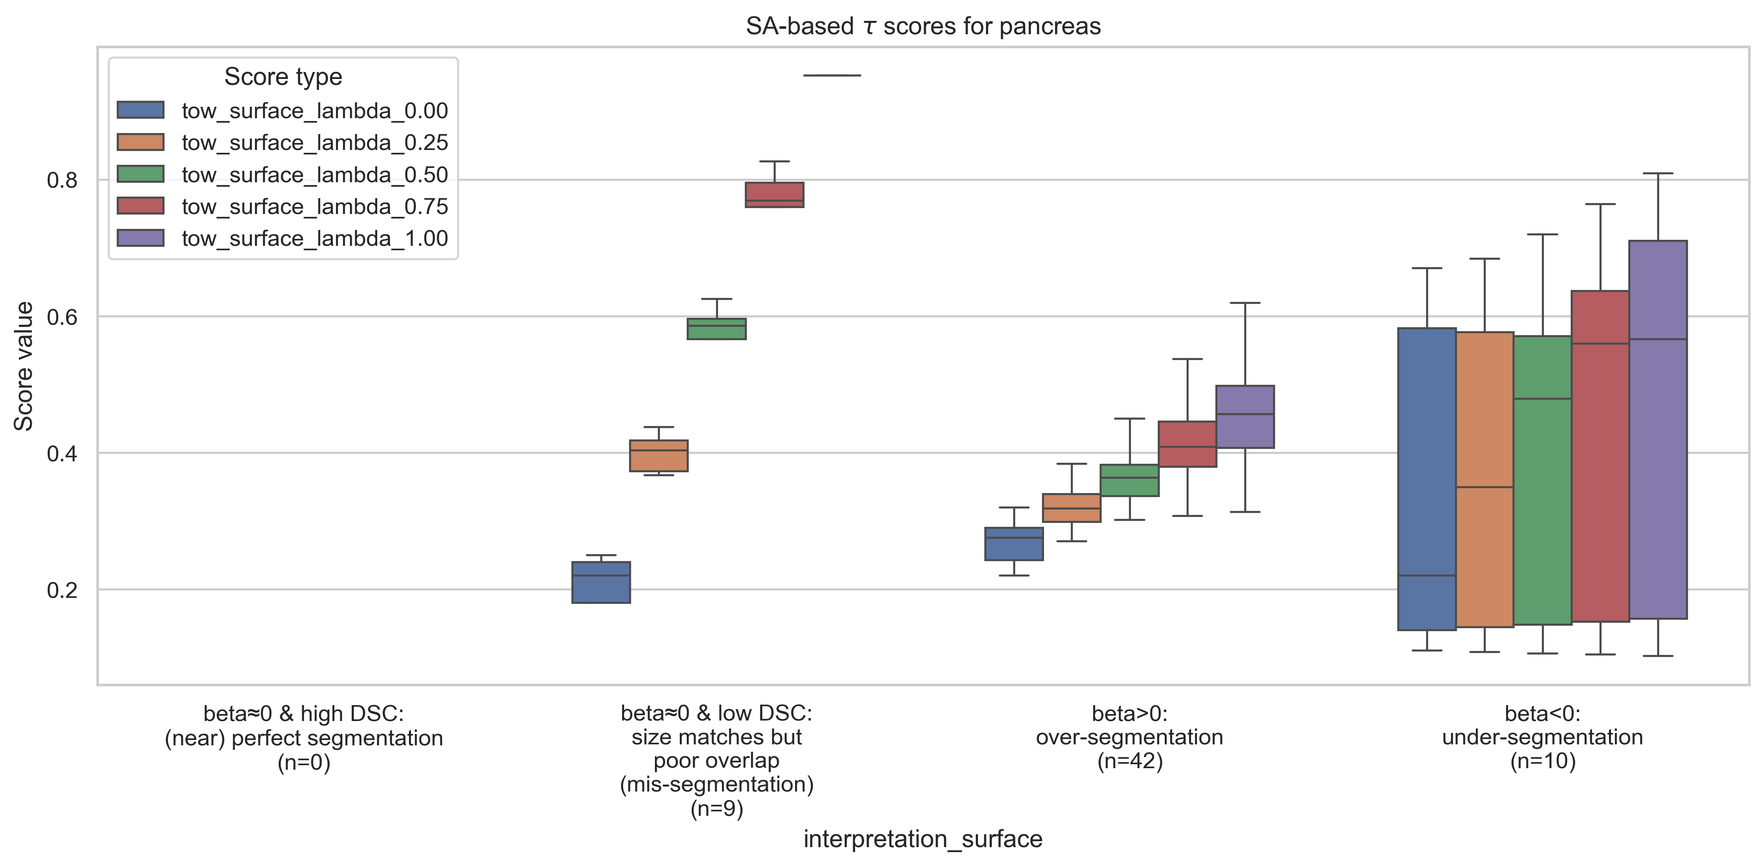
Proposed method ($β$ + $combined error E$) – with Quality of Segmentation Score $τ$
Pancreas (Difficult – low DSC organ) → SA-based $β$, $DSC$, $E$
Error, $E = \sqrt{{\{λβ\}}^{2}+{\{\left(1−λ\right)(1−DSC)\}}^{2}} \text{∈ } \text{[0, 1]}$
$${DSC}_{high}=80\%=0.80$$
|$β_{tolerance}|=2\%=0.02$
$$\&$$

Slide 53
Proposed method ($β$ + $combined error E$) – with Quality of Segmentation Score $τ$
— Across organs
Across organs – Liver, Stomach, Pancreas → Volume-based $β$, $DSC$, $E$
$${DSC}_{high}=80\%=0.80$$
|$β_{tolerance}|=2\%=0.02$
$$\&$$

Slide 54
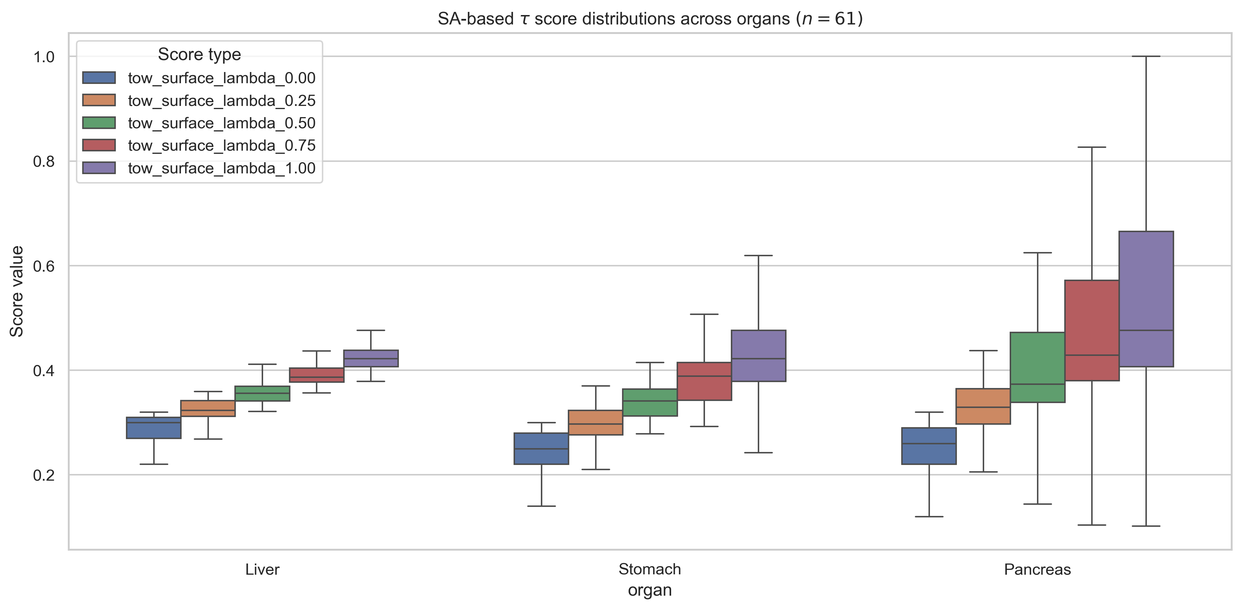
Proposed method ($β$ + $combined error E$) – with Quality of Segmentation Score $τ$
— Across organs
Across organs – Liver, Stomach, Pancreas → SA-based $β$, $DSC$, $E$
$${DSC}_{high}=80\%=0.80$$
|$β_{tolerance}|=2\%=0.02$
$$\&$$

Slide 55
Combined score, C
Combined score, $C=λ\frac{β+1}{2}+\left(1−λ\right)DSC$
Assumption: During over-segmentation, $Surface area (Pd)≤2×Surface area (GT)$
1. Difficult to interpret.
2. Loss of information.
3. Need a classifier/ more rule-based processing to draw meaningful segmentation error type categories from these combined C scores.
4. Highly dependent on the optimal selection of hyperparameter $λ$, $λ^{∗}$. And, optimal $λ^{∗}$ varies from dataset to dataset.

Slide 56
Results 2 – Statistical
R2c: $C$ scores across organs
Q1: How do $C$ scores perform across organs?
First, a sanity check:
1. When $λ=0$.00: We fully utilize $DSC$ ➔ $C=DSC$
2. When $λ=0.50$: We give 50% importance to $β$ and $DSC$ ➔ $C=\frac{DSC + {(β+1)}/2}{2}$
3. When $λ=1.00$: We fully utilize $β$ ➔ $C=\frac{β+1}{2}$

Slide 57
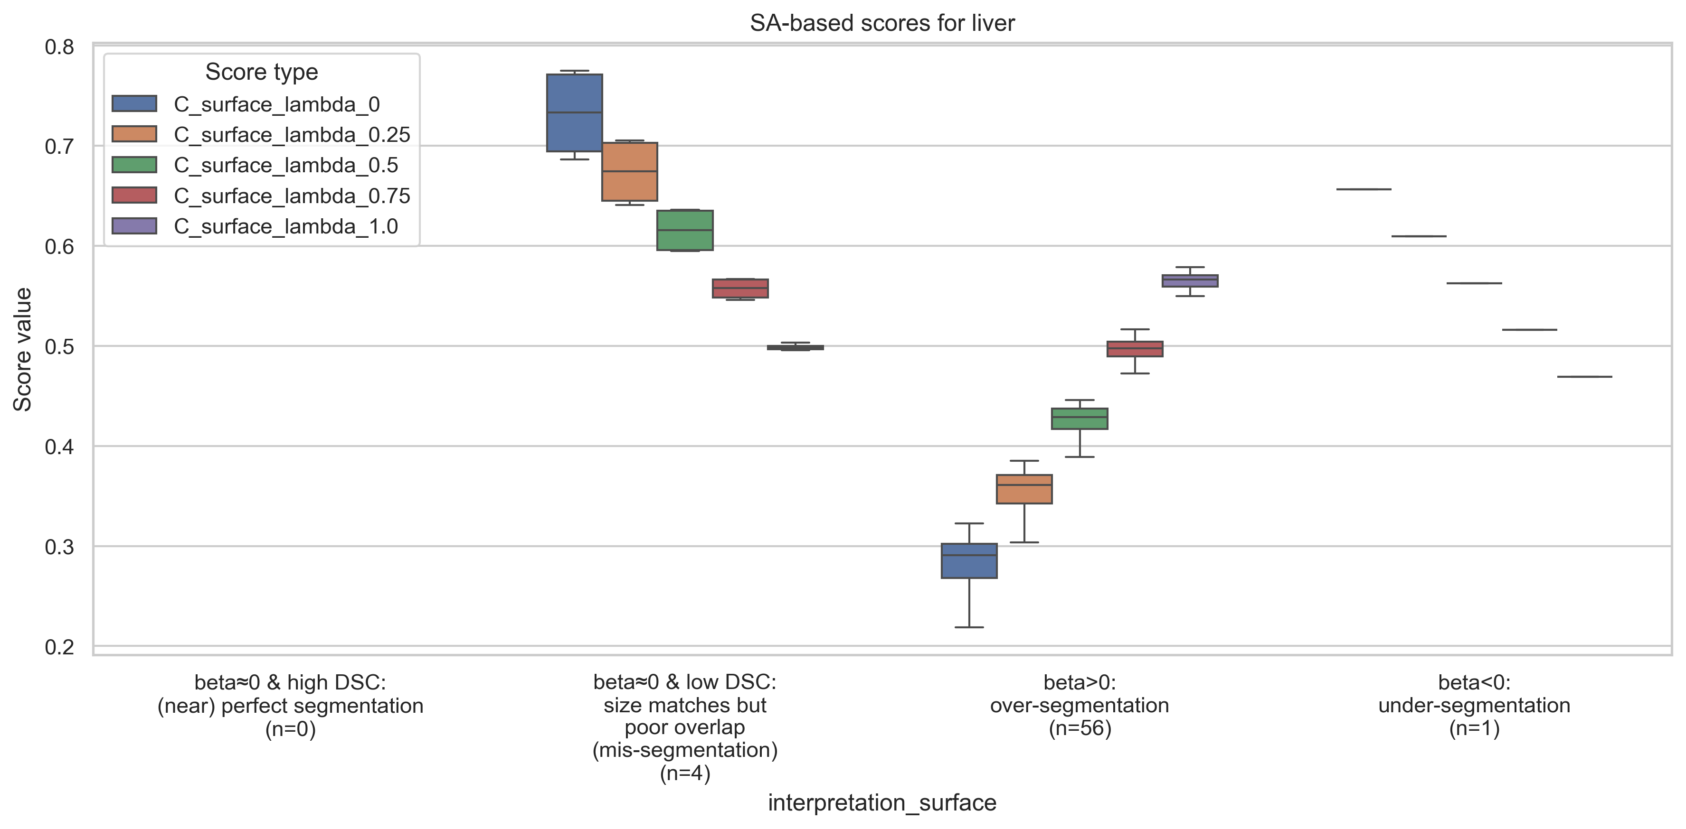
Combined $β−DSC$ score, $C$
Liver (Easy – high DSC organ)
$$C=λ\frac{β+1}{2}+\left(1−λ\right)DSC$$
$${DSC}_{high}=80\%=0.80$$
|$β_{tolerance}|=2\%=0.02$
$$\&$$

Slide 58
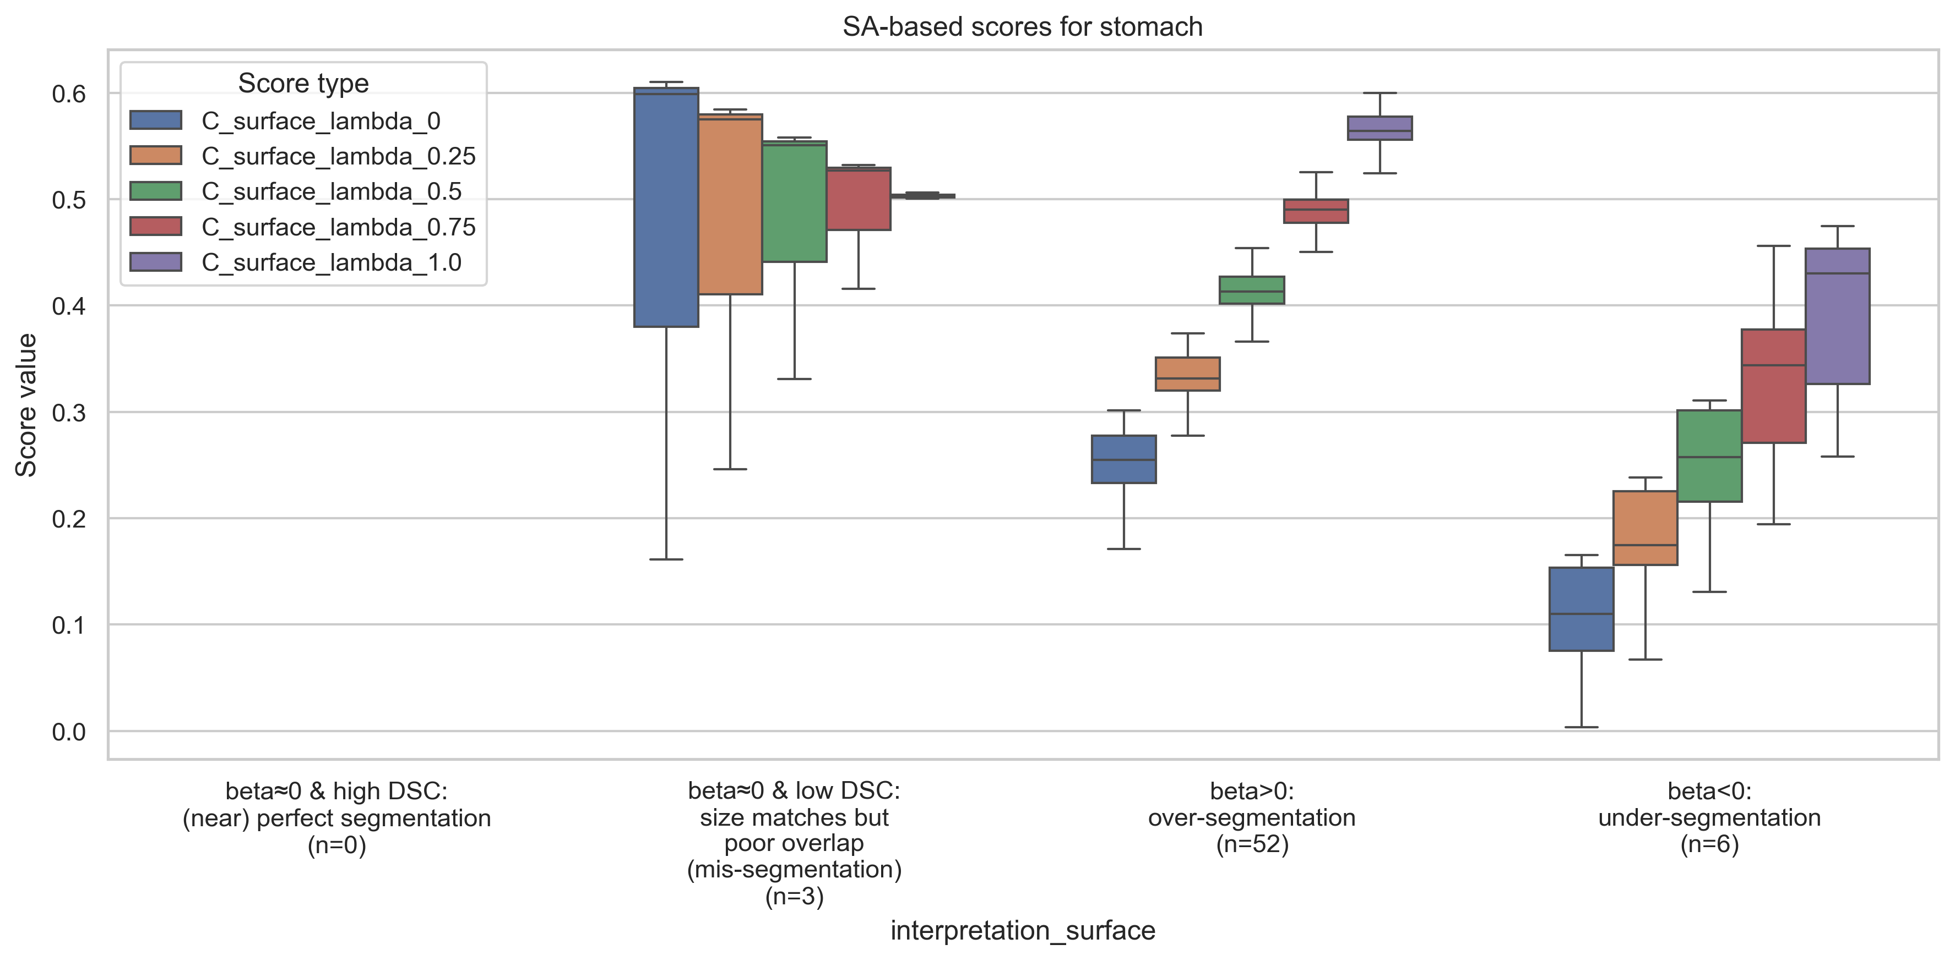
Combined $β−DSC$ score, $C$
Stomach (Moderate – medium DSC organ)
$$C=λ\frac{β+1}{2}+\left(1−λ\right)DSC$$
$${DSC}_{high}=80\%=0.80$$
|$β_{tolerance}|=2\%=0.02$
$$\&$$

Slide 59
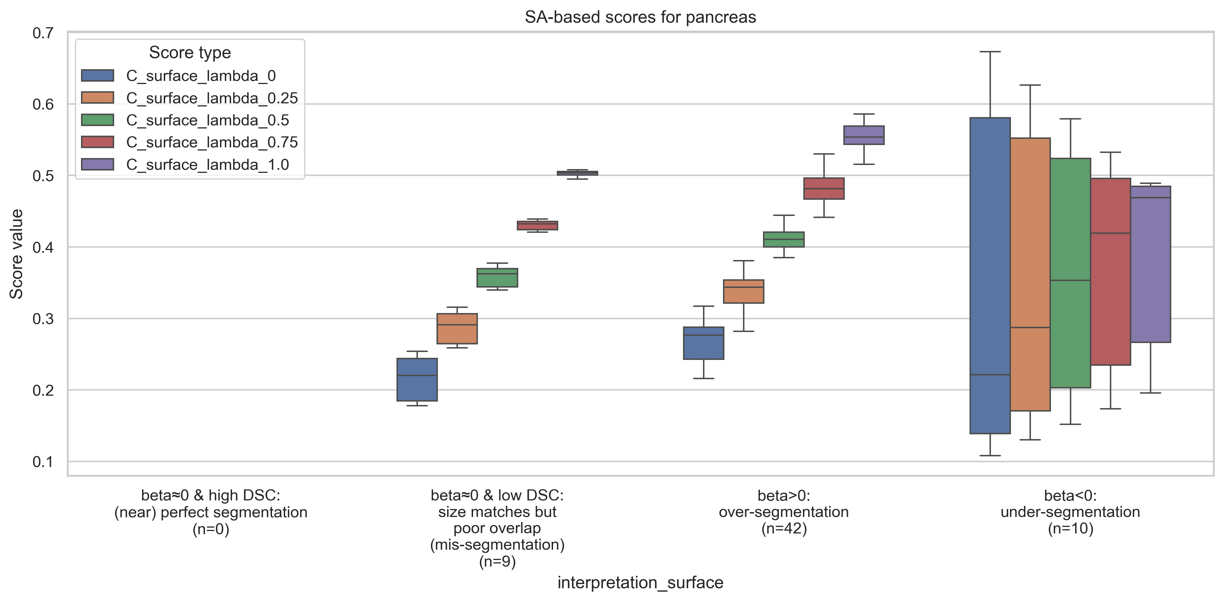
Combined $β−DSC$ score, $C$
Pancreas (Difficult – low DSC organ)
$$C=λ\frac{β+1}{2}+\left(1−λ\right)DSC$$
$${DSC}_{high}=80\%=0.80$$
|$β_{tolerance}|=2\%=0.02$
$$\&$$

Slide 60
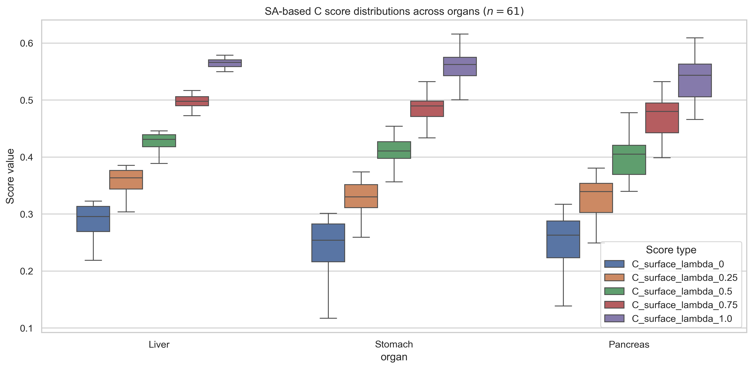
Combined $β−DSC$ score, $C$
— Across organs
Across organs – Liver, Stomach, Pancreas
$$C=λ\frac{β+1}{2}+\left(1−λ\right)DSC$$
$${DSC}_{high}=80\%=0.80$$
|$β_{tolerance}|=2\%=0.02$
$$\&$$

Slide 61
Methods
— Revised study workflow

Slide 62
Methods
— Previous version
Previous version of study workflow (for reference)

Slide 63
Methods – previous version
— What questions are we asking specifically?
Q1: Can we rank organs as per susceptibility to being under- or over-segmented?
Q2: Organ-wise characterization of more nuanced errors
Comparative analyses: How does the segmentation model erroneously alter the segmentation characteristics of the organ?
Causal analyses: What features lead to what kinds of errors?

Slide 64
Methods – previous version
— What questions are we asking specifically? (2)
Q3: Magnitude and direction of error relative to the organ
Q4: Which organ-specific features are scalable, and by how much?
Comparative analyses: What are the exceptions?
Causal analyses: Why the exceptions?

Slide 65
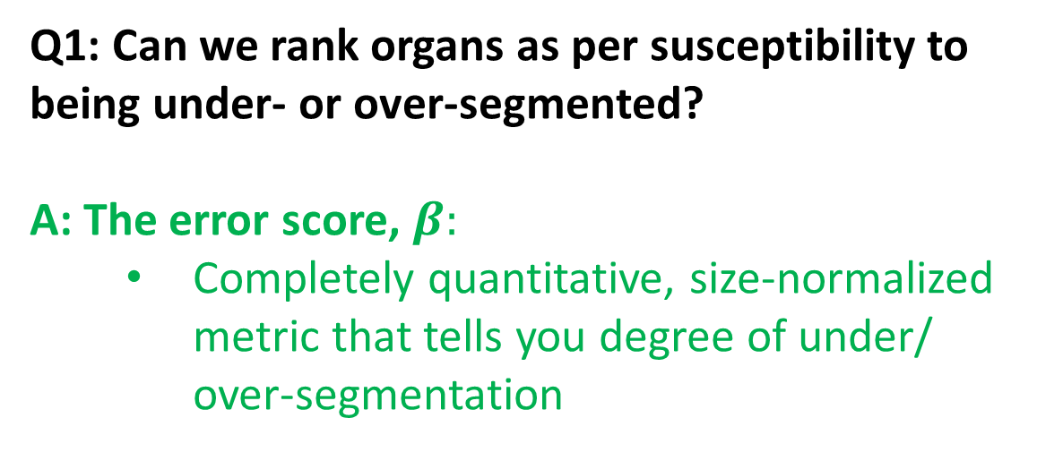
Methods – previous version
— How do we answer these questions?
Q1: Can we rank organs as per susceptibility to being under- or over-segmented?
A: The error score, $β:$
Completely quantitative, size-normalized metric that tells you degree of under/ over-segmentation

Slide 66
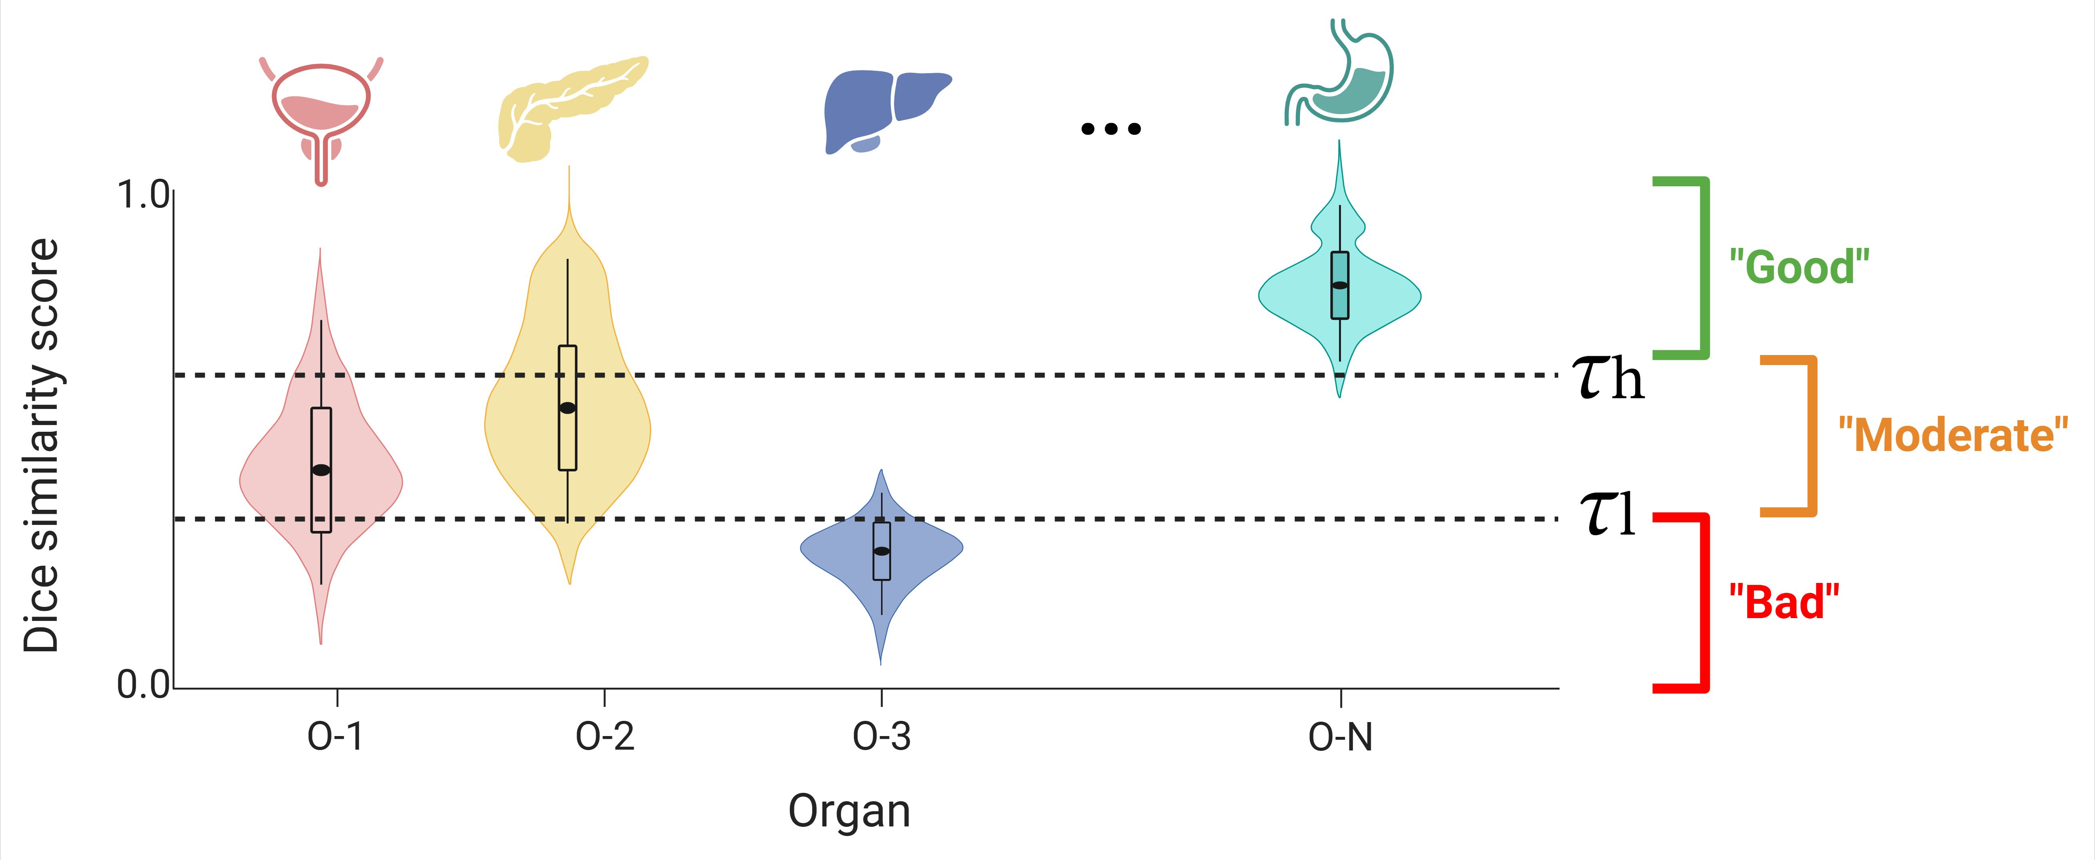
Methods – previous version
How is our Phase 1 different from literature?
– Putting our “What” and “How” in perspective
Q1: Ranking organs as per susceptibility to being under- or over-segmented
State-of-the-art (segmentation QA)
Our Phase 1 (extent of under-/ over-segmentation)

Slide 67
Methods
— Previous version
End of previous version of study workflow

Slide 68
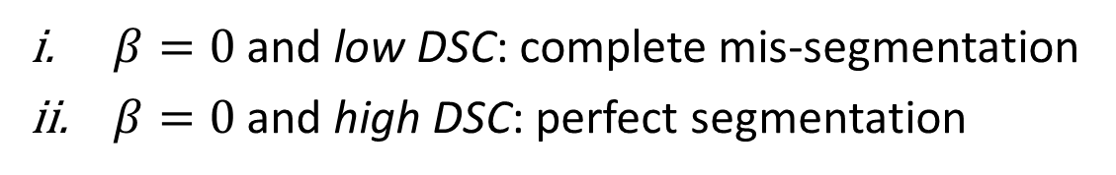
Methods
– Extending the “How”
Q1: Ranking organs as per susceptibility to being under- or over-segmented (2)
SA-based error score, $β=\frac{Surface area \left(Pd\right)−Surface area (GT)}{Surface area (GT)}$
Volume-based error score, $β=\frac{Volume \left(Pd\right)−Volume(GT)}{Volume(GT)}$
$β>0:$ over-segmentation
$β<0:$ under-segmentation
$β=0:$ Either perfect segmentation,
or complete mis-segmentation
$β=0$ and low DSC: complete mis-segmentation
$β=0$ and high DSC: perfect segmentation

Slide 69
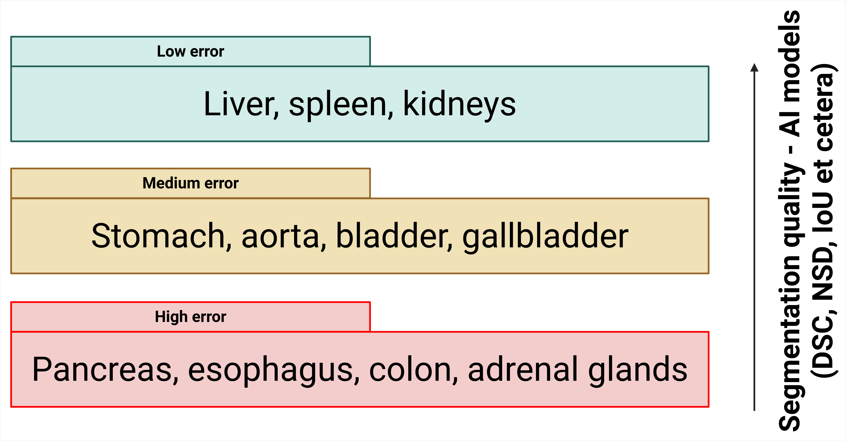
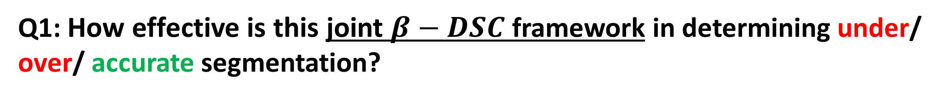
Results – visual examples
Efficacy of the joint $β−DSC$ framework
Q1: How effective is this joint $β−DSC$ framework in determining under/ over/ accurate segmentation?
Examples shown on 6 samples per organ. (Note: only 3D rendering, not 2D.)
But first, let us recap the organs of interest:
[1] Sun Kyung Jeon et al, “Fully-Automated Multi-Organ Segmentation …,” Scientific Reports, 2022.
[2] Xiangde Luo et al, “WORD,” Medical Image Analysis, 2022.
[3] Yuanfeng Ji et al, “AMOS,” arXiv, 2022.
[4] Jakob Wasserthal et al, “TotalSegmentator,” Radiology: Artificial Intelligence, 2023.

Slide 70
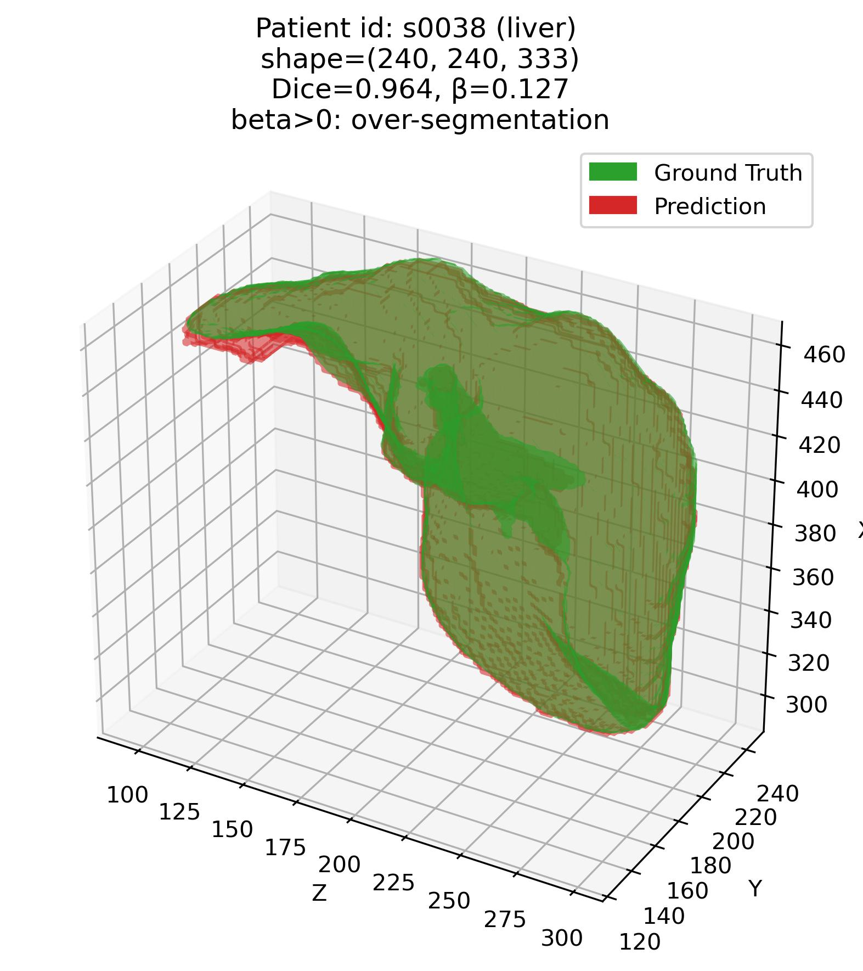
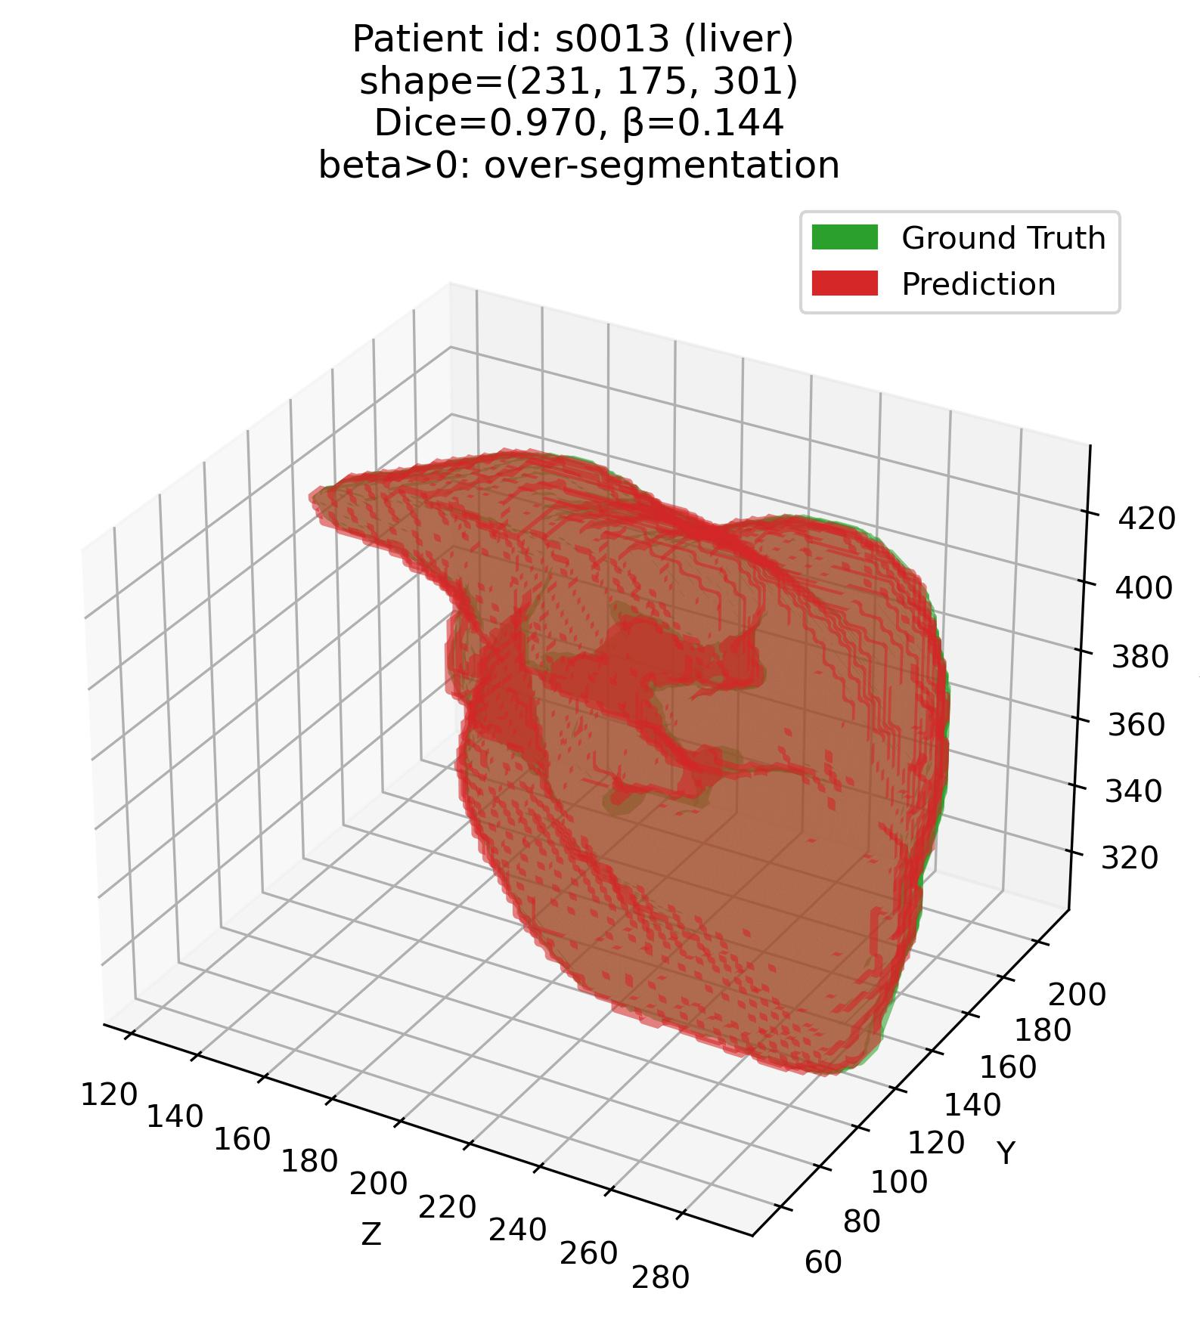

Results
Efficacy of the joint $β−DSC$ framework
Q1: Some examples – 1. Liver (Easy – high DSC organ)
$${DSC}_{high}=80\%=0.80$$
|$β_{tolerance}|=2\%=0.02$
$$\&$$

Slide 71



Results
Efficacy of the joint $β−DSC$ framework
Q1: Some examples – 1. Liver (Easy – high DSC organ)

Slide 72



Results
Efficacy of the joint $β−DSC$ framework
Q1: Some examples – 2. Stomach (Moderate – average DSC organ)

Slide 73



Results
Efficacy of the joint $β−DSC$ framework
Q1: Some examples – 2. Stomach (Moderate – average DSC organ)

Slide 74



Results
Efficacy of the joint $β−DSC$ framework
Q1: Some examples – 3. Pancreas (Difficult – low DSC organ)

Slide 75



Results
Efficacy of the joint $β−DSC$ framework
Q1: Some examples – 3. Pancreas (Difficult – low DSC organ)

Slide 76
Methods
– Extending the “How”
Q1: Ranking organs as per susceptibility to being under- or over-segmented (2)
SA-based error score, $β=\frac{Surface area \left(Pd\right)−Surface area (GT)}{Surface area (GT)}$
Volume-based error score, $β=\frac{Volume \left(Pd\right)−Volume(GT)}{Volume(GT)}$
$β>0:$ over-segmentation
$β<0:$ under-segmentation
$β=0:$ Either perfect segmentation,
or complete mis-segmentation
$β=0$ and low DSC: complete mis-segmentation
$β=0$ and high DSC: perfect segmentation
Therefore, setting an upper and lower bound (thresholds) on $β$ and DSC solve the problem.

Slide 77


Results 2 – Statistical
R2a: Volume- and SA-based $β−DSC$ framework for error characterization
Q1: Liver (Easy – high DSC organ)
$${DSC}_{high}=80\%=0.80$$
|$β_{tolerance}|=2\%=0.02$
$$\&$$

Slide 78


Results 2 – Statistical
R2a: Volume- and SA-based $β−DSC$ framework for error characterization
Q1: Stomach (Moderate – average DSC organ)
$${DSC}_{high}=80\%=0.80$$
|$β_{tolerance}|=2\%=0.02$
$$\&$$

Slide 79


Results 2 – Statistical
R2a: Volume- and SA-based $β−DSC$ framework for error characterization
Q1: Pancreas (Difficult – low DSC organ)
$${DSC}_{high}=80\%=0.80$$
|$β_{tolerance}|=2\%=0.02$
$$\&$$

Slide 80


Results 2 – Statistical
R2b: Comparison of Volume- vs. SA-based $β−DSC$ framework for error characterization
Q1: How do the volume- vs. SA-based scores perform across organs?
$${DSC}_{high}=80\%=0.80$$
|$β_{tolerance}|=2\%=0.02$
$$\&$$

Slide 81
Next step
– And why is it relevant?
Unifying $β$ and $DSC$
Why is a quantitative metric of under-/ over-segmentation important?
With a quantitative metric, we can perform correlation, regression et cetera to infer:
What organ features are susceptible to under-/ over-segmentation?
What region in the organ is susceptible to be under-/ over-segmented?
Correlation-/ regression-based analyses are impossible with categorical independent variables.
1. Primary goal: Identifying and characterizing types (not extent, type) of segmentation errors
2. Secondary goal: Fine-grained (specific), completely quantitative, scalable error characterization framework.

Slide 82


Results 2 – Statistical
R2c: $C$ scores across organs
Q1: How do $C$ scores perform across organs? (2)
Sanity check:

Slide 83


Results 2 – Statistical
R2c: $C$ scores across organs
Q1: How do $C$ scores perform across organs? (3)
Liver (Easy – high $DSC$ organ):

Slide 84


Results 2 – Statistical
R2c: $C$ scores across organs
Q1: How do $C$ scores perform across organs? (3)
Stomach (Moderate – medium $DSC$ organ):

Slide 85


Results 2 – Statistical
R2c: $C$ scores across organs
Q1: How do $C$ scores perform across organs? (3)
Pancreas (Difficult – low $DSC$ organ):

Slide 86

An important observation
– And how to address this?
TotalSegmentator (nn-UNet 3D V1) loves to connect disconnected components.
Axiom 1. However, itself sometimes generates disconnected segmentations for connected components.
Axiom 2. Very good at naturally combining disconnected components – almost like “correcting” manual annotation.
Axiom 3. ${Literature}^{\text{[∗]}}$ often suggests that 3D segmentation models perform badly when:
Tiny GT (prostate, various glands – including adrenal glands, urinary bladder)
Complex-shaped GT (esophagus, pancreas, intestines, colon)
However, my observation has been: Disconnected components are a MAJOR factor for a specific kind of over-segmentation.
Axiom 4. Not just ANY over-segmentation – I need to figure out a way to quantify this particular kind of over-segmentation.
[*] Saporta, Adriel, Xiaotong Gui, Ashwin Agrawal, Anuj Pareek, Steven Q. H. Truong, Chanh D. T. Nguyen, Van-Doan Ngo, et al. 2022. “Benchmarking Saliency Methods for Chest X-Ray Interpretation.” Nature Machine Intelligence 4 (10): 867–78.

Slide 87


An important observation
– And how to address this?
TotalSegmentator (nn-UNet 3D V1) loves to connect disconnected components.
Axiom 1. Itself sometimes generates disconnected segmentations for connected components.

Slide 88



An important observation
– And how to address this?
TotalSegmentator (nn-UNet 3D V1) loves to connect disconnected components.
Axiom 2. Very good at naturally combining disconnected components – almost like “correcting” manual annotation.

Slide 89
Recap of to-dos for next week
– What do I want to address/ answer?
1. Combined $β−DSC$ score, $C=λ\frac{β+1}{2}+\left(1−λ\right)DSC$
– For shape match but low DSC (mis-segmentation) versus over/ under segmentation?
2. Quantifying # of connected components + shape completeness/ congruency
Just quantification of over-segmentation error does not suffice – this is a special case.

Slide 90


Summarizing it all
– What was done last week? What is to be done next week?
Past week: What was expected, what was accomplished?
TotalSegmentator → all samples, all organs.
Joint $error score (β)−DSC$ framework coded.
This framework was applied on all eleven, selected abdominal organs.
Observations made.
Combined formulation proposed for the joint score.
Next week: What is expected?
Complete implementation combined score, $C$ for shape match but low DSC (mis-segmentation) versus over/ under segmentation.
Formulate metric to quantify connected component behavior.

Slide 91
Error characterization protocol
References
[1] Jeon, Sun Kyung, Ijin Joo, Junghoan Park, Jong-Min Kim, Sang Joon Park, and Soon Ho Yoon. 2024. “Fully-Automated Multi-Organ Segmentation Tool Applicable to Both Non-Contrast and Post-Contrast Abdominal CT: Deep Learning Algorithm Developed Using Dual-Energy CT Images.” Scientific Reports 14 (1): 4378.
[2] Luo, Xiangde, Wenjun Liao, Jianghong Xiao, Jieneng Chen, Tao Song, Xiaofan Zhang, Kang Li, Dimitris N. Metaxas, Guotai Wang, and Shaoting Zhang. 2022. “WORD: A Large Scale Dataset, Benchmark and Clinical Applicable Study for Abdominal Organ Segmentation from CT Image.” Medical Image Analysis 82 (102642): 102642.
[3] Ji, Yuanfeng, Haotian Bai, Jie Yang, Chongjian Ge, Ye Zhu, Ruimao Zhang, Zhen Li, et al. 2022. “AMOS: A Large-Scale Abdominal Multi-Organ Benchmark for Versatile Medical Image Segmentation.” arXiv [Eess.IV]. arXiv. https://proceedings.neurips.cc/paper_files/paper/2022/file/ee604e1bedbd069d9fc9328b7b9584be-Paper-Datasets_and_Benchmarks.pdf.
[4] Wasserthal, Jakob, Hanns-Christian Breit, Manfred T. Meyer, Maurice Pradella, Daniel Hinck, Alexander W. Sauter, Tobias Heye, et al. 2023. “TotalSegmentator: Robust Segmentation of 104 Anatomic Structures in CT Images.” Radiology. Artificial Intelligence 5 (5): e230024.
[5] Bionetworks, Sage. n.d. “Multi-Atlas Labeling Beyond the Cranial Vault - Workshop and Challenge.” Accessed December 16, 2025. https://www.synapse.org/Synapse:syn3193805/wiki/89480.

Slide 92
Error characterization protocol
References
[6] “MICCAI FLARE 2022 - Grand Challenge.” n.d. Grand-challenge.org. Accessed December 16, 2025. https://flare22.grand-challenge.org/.
[7] Saporta, Adriel, Xiaotong Gui, Ashwin Agrawal, Anuj Pareek, Steven Q. H. Truong, Chanh D. T. Nguyen, Van-Doan Ngo, et al. 2022. “Benchmarking Saliency Methods for Chest X-Ray Interpretation.” Nature Machine Intelligence 4 (10): 867–78.

Slide 93
Error characterization protocol
Appendices
Appendices

Slide 94
Error characterization protocol
Appendices
A1. Next steps in the “How?”

Slide 95

A1. Next steps in the “How?”
Recap – Phase 1
Q1: Can we rank organs as per susceptibility to being under- or over-segmented?
A: The error score, $β:$
Completely quantitative, size-normalized metric that tells you degree of under/ over-segmentation

Slide 96
A1. Next steps in the “How?”
Phase 2
Q2: Organ-wise characterization of more nuanced errors
Comparative analyses:
Same feature b/w ground truth (GT) & predicted (Pd)
Correlation
Simple linear regression
Explanatory (causal) analyses:
Different feature between GT and Pd
Regression
Correlation

Slide 97
A1. Next steps in the “How?”
Phase 3
Q3: Magnitude and direction of error relative to the organ
Magnitude and direction of anisotropy + DSC:
DSC + Magnitude of anisotropy + Direction
Combines magnitude, direction, normalization by size, ignores local statistics:
Shape preservation metric, M1

Slide 98

A1. Next steps in the “How?”
Phase 4
Q4: Which organ-specific features are scalable, and by how much?
Comparative analysis:
What are the exceptions?
Explanatory (causal analyses):
Why the exceptions?
Framework, F1
Fit decision tree classifier to identify what combinations of feature values lead to low versus high deformation ($ΔE$).

Slide 99
Error characterization protocol
Appendices
A2. Methods
– Extending the “How”

Slide 100
A2. Methods
Extending the “How”
Q2: Organ-wise characterization of more nuanced errors
Types of analyses:
1. Purely comparative
2. Explanatory (causal)
How does the segmentation model wrongly alter the segmentation characteristics of the organ?
What organ features lead to what kinds of errors?
Examples
Examples
E1. Do models tend to make elongated structured more circular?
E1. Does a rectangular liver lead to under-segmentation as compared to a spherical liver?
E2. Do models tend to combine small sub-structures into a bigger structure?
E2. Is a complex shape more likely to be over-segmented?

Slide 101



A2. Methods
Extending the “How”
Q2: Organ-wise characterization of more nuanced errors (2)
1. Purely comparative analyses:
E1. Do models tend to make elongated structured more circular?
E2. Do models tend to combine small sub-structures into a bigger structure?
E3. Do models tend to make nuanced shapes seem more simplistic?
Comparison criteria: same feature in the GT and Pd segmentations.

Slide 102
A2. Methods
Extending the “How”
Q2: Organ-wise characterization of more nuanced errors (3)
1. Purely comparative analyses (contd.):
Comparison techniques:
Correlation
Regression (e.g. Simple Linear Regression)
Regression coefficient tells us how much the feature F of the Pd segmentation increases (+ve) or decreases (-ve) with unit increase in F of GT.

Slide 103
A2. Methods
Extending the “How”
Q2: Organ-wise characterization of more nuanced errors (4)
2. Explanatory (causal) analyses:
E1. Does a rectangular liver lead to under-segmentation as compared to a spherical liver?
E2. Is a complex shape more likely to be over-segmented?
Comparison criteria: different feature $F_{x}$ in the GT as $F_{y}$ for Pd segmentations.
Note: Error score $β$, is one of the $F_{y}$ features, as we are also interested in what shape statistics might be causing under- or over-segmentation.

Slide 104

A2. Methods
Extending the “How”
Q2: Organ-wise characterization of more nuanced errors (5)
2. Explanatory (causal) analyses (contd.):
Comparison techniques:
Correlation
Regression (e.g. Simple Linear Regression)

Slide 105
A2. Methods
Extending the “How”
Q2: Organ-wise characterization of more nuanced errors (6)
Features of interest:
1. Measures of anisotropy
2. Features of shape-based complexity
Anisotropy: The elongatedness (non-symmetry) of the 3D shape as a whole.
Exploratory, based on results. I want to follow a similar approach.
Saporta et al 2022 paper [7] features.

Slide 106



A2. Methods
Extending the “How”
Q2: Organ-wise characterization of more nuanced errors (7)
1. Features of interest – measures of anisotropy:
i. Sphericity: How closely does a 3D shape resemble a sphere?
$$sphericity (V, A)$$
$$\frac{surface area of sphere with volume V}{surface area of the actual object (A)} =\frac{\sqrt[3]{36πV^{2}}}{A}$$

Slide 107



A2. Methods
Extending the “How”
Q2: Organ-wise characterization of more nuanced errors (8)
1. Features of interest – measures of anisotropy (contd.):
ii. Relative surface area excess (RSAE): Ratio of excessive surface area of given 3D geometry, relative to that of largest sphere that can fit completely within the geometry.
$$RSAE$$
$$\frac{Excess surface area (ΔA)}{surface area of largest sphere}$$

Slide 108
A2. Methods
Extending the “How”
Q2: Organ-wise characterization of more nuanced errors (9)
2. Features of interest – shape-based complexity:
Influenced heavily by Saporta et al 2022 paper [7] features → although they used saliency maps.
They followed an exploratory approach – I want to do the same.
Not exactly sure what features are the best – without some results.
Using the features in the Saporta et al 2022 [7] paper as a placeholder/ comparison.

Slide 109

A2. Methods
Extending the “How”
Q2: Organ-wise characterization of more nuanced errors (10)
2. Features of interest – shape-based complexity (contd.):

Slide 110


A2. Methods
Extending the “How”
Q3: Magnitude & direction of error relative to the organ
Goal: Develop a combined metric of 1. anisotropy and 2. direction of the aforementioned anisotropy relative to the organ.
Shape preservation metric$, M1$.

Slide 111



A2. Methods
Extending the “How”
Q3: Magnitude & direction of error relative to the organ (2)
Step 1: Tensor representation of the 3D geometry.
The tensor represents:
Direction of maximum elongation
How elongated the shape is in each axis (x, y, z).
Calculate ${\{λ}_{1},λ_{2},λ_{3}\}$ and $\{{v_{1}}^{→},{v_{2}}^{→},{v_{3}}^{→}\}$ from the shape tensor:
[Note: Detailed math provided in protocol]
$\{{v_{1}}^{→},{v_{2}}^{→},{v_{3}}^{→}\}$ provide the directions of $\{l, b, h\}$.
${\{λ}_{1},λ_{2},λ_{3}\}$ provide the magnitude of elongation along $\{{v_{1}}^{→},{v_{2}}^{→},{v_{3}}^{→}\}$.

Slide 112


A2. Methods
Extending the “How”
Q3: Magnitude & direction of error relative to the organ (3)
Step 2: Calculate absolute difference in deformation b/w GT and Pd segmentation.
Note: Direction not incorporated in this step, only magnitude of difference.
$Elongation (E) =\sqrt{\frac{λ_{2}}{λ_{1}}}$
$ΔE=| E_{GT}−E_{Pd} |$

Slide 113
A2. Methods
Extending the “How”
Q3: Magnitude & direction of error relative to the organ (4)
Step 3: Find alignment b/w major axes of GT and Pd segmentation – How aligned are they?
Note: Direction incorporated in this step.
$Alignment {\left(φ\right)=cos}^{−1}\text{|}{v_{1, GT}}^{→}\text{. }{v_{1, Pd}}^{→}\text{|​}$

Slide 114

A2. Methods
Extending the “How”
Q3: Magnitude & direction of error relative to the organ (5)
Reporting elongation + alignment metrics + DSC/NSD/IoU:
DSC/NSD/IoU → for overlap,
$ΔE$ → for magnitude of elongation, and
$φ$ → for alignment of elongation
… between GT and Pd segmentation.
Can be reported per-organ like we do DSC.
But, comparative or explanatory (causal) analyses impossible → because correlation/ regression impossible.

Slide 115
A2. Methods
Extending the “How”
Q3: Magnitude & direction of error relative to the organ (5)
Bringing all the components together:
Shape preservation metric, $M1=e^{−ΔE}\text{|}{v_{1, GT}}^{→}\text{. }{v_{1, Pd}}^{→}\text{|​}$
$Range of M1:$
$0,$ when shape is perfectly preserved b/w GT and Pd segmentations.
$1,$ when shape is completely lost b/w GT and Pd segmentations.
Comparative or explanatory (causal) analyses possible → because correlation/ regression possible.

Slide 116
A2. Methods
Extending the “How”
Q4: Scalability analyses
Which organ-specific features are scalable – and by how much?
Assumption: I have formulated a good metric that unifies $β$ and $DSC$.
In progress: $β=kβ+\left(1−DSC\right),$ where $0≤k≤1$ controls to what extent $β$ is to be used.

Slide 117




A2. Methods
Extending the “How”
Q4: Scalability analyses (2)
Step 1: Fit a Gaussian mixture model (GMM) to the error score ($β$) per organ. Subsequently, find optimal number of components (N) in the GMM-fitted data.
Example data: Histogram of $β$ values
GMM fit on $β$ values (3 modes)

Slide 118
A2. Methods
Extending the “How”
Q4: Scalability analyses (2)
Step 2: Extract shape-based features from each of the 3 components corresponding to “under,” “mixed” and “over” segmentation – based on $β−DSC$ combinations.
Step 3: Perform feature selection to find features that are most important in classifying “under,” “mixed” and “bad” segmentations.
⇒ Example: Say, livers that have low circularity, high area and high circumference are associated with “over” segmentations.

Slide 119
A2. Methods
Extending the “How”
Q4: Scalability analyses (3)
Going one level deeper:
For feature values that have been identified as causing errors in under/ mixed/ over segmentation, can we tell if they lead to a specific type of under/ mixed/ over segmentation?
⇒ Example before: Say, livers that have low circularity, high area and high circumference are associated with “over” segmentations.
Step 4: Label each “over” segmentation as “low deformation” (preserves GT shape — low $ΔE$), or “high deformation” (does not preserve GT shape — high $ΔE$).

Slide 120
A2. Methods
Extending the “How”
Q4: Scalability analyses (4)
Step 5. Fit a decision tree classifier to identify what combinations of feature values lead to low versus high deformation.
⇒ This could be done for any number of aforementioned features — often in the order that we are interested in to get more fine-grained insights.

Slide 121
Error characterization protocol
Appendices
A3. Organs arranged in order of difficulty of segmentation

Slide 122

Organ-wise segmentation quality
... And the organs that we are focusing on
Several benchmarking studies exist, which categorize organs based on difficulty of segmentation by AI-based models [1—4]:
Score | Explanation
Dice Similarity Coefficient (DSC) | Volume (V) overlap
Intersection over Union (IoU) | Surface area (SA) overlap
Normalized Surface Dice (NSD) | Boundary overlap within tolerance distance $t$.
[1] Jeon et al, 2024, Scientific Reports.
[3] Ji et al, 2022, “AMOS,” arXiv, PDF.
[2] Luo et al, 2022, Medical Image Analysis.
[4] Wasserthal et al, 2023, “TotalSegmentator,” Radiology. Artificial Intelligence.

Slide 123
Error characterization protocol
Appendices
A4. Design decisions

Slide 124
A4. Design decisions
D1 – Organs that we are focusing on
D1 – Organs that we are focusing on:
At least for the initial analyses, we focus on the organs fully contained within abdominal CT volumes, namely:
To be excluded:
1. Small intestine
2. Appendix
3. Bile ducts
4. Inferior vena cava
5. Arteries and veins
6. Spine
8. Lymph nodes
9. Lower ribs
1. Liver
2. Pancreas
3. Esophagus
4. Kidneys
5. Adrenal glands
6. Stomach
7. Colon
8. Bladder
9. Gallbladder
10. Aorta

Slide 125
A4. Design decisions
D1 – Organs that we are focusing on (2)
D1 – Organs that we are focusing on (2):
Why small intestine, appendix, bile ducts, inferior vena cava, arteries and veins, lymph nodes, spine and lower ribs are not included:
They are not “popular” organs, meaning I have not seen them being segmented in many abdominal CT studies.
Consequently, not all databases have these ground truths.
Small intestine, large intestine → often tough to differentiate, also not complete in abdominal CT scans often.
Spine → Not a “popular” thing, also not completely contained in abdominal CT scans.

Slide 126
A4. Design decisions
D2 – CT datasets to be used in the study
D2 – CT datasets to be used in the study:
Selection criteria:
We plan on running pre-trained AI segmentation models on popular CT datasets that fulfill the following criteria:
Criteria 1: Contain either all or a subset of the 11 aforementioned, popular (meaning, commonly studied in segmentation studies on CT datasets), abdominal organs that we are interested in:
1. Liver
2. Pancreas
3. Esophagus
4. Kidneys
5. Adrenal glands
6. Stomach
7. Colon
8. Bladder
9. Gallbladder
10. Aorta

Slide 127
A4. Design decisions
D2 – CT datasets to be used in the study (2)
D2 – CT datasets to be used in the study (2):
Criteria 2: Contain at least 30 CT volumes.
Criteria 3: All volumes in 3D — not 2D (meaning, having multiple 2D slices).
Criteria 4: Have published an AI segmentation model on their data — or are popular enough. Meaning, published at a popular venue such as NeurIPS, CVPR, MICCAI, MIDL et cetera — and therefore have an extensive leaderboard.

Slide 128
A4. Design decisions
D2 – CT datasets to be used in the study (3)
D2 – CT datasets to be used in the study (3):
I plan on using 6, 3D CT datasets that follow the aforementioned criteria:
The DECT/ SECT dataset [1]
TotalSegmentator [4]
WORD [2]
BTCV [5]
AMOS [3]
FLARE [6]

Slide 129
A4. Design decisions
D3 – AI segmentation models
D3 – AI segmentation models:
4 popular nnUNET-based models + TotalSegmentator:
nnUNET (2D)
nnUNET (3D)
nnUNETV2 (2D)
nnUNETV2 (3D)
TotalSegmentator: It is not a new model methodologically, it is just nnUNet (3D) trained on all organs in the body, across 1200 3D volumes.

Slide 130
A4. Design decisions
D3 – AI segmentation models (2)
D3 – AI segmentation models (2):
However, for now, we will not use all models – only nnUNET (3D) and TotalSegmentator:
nnUNET (2D)
nUNET (3D) – and TotalSegmentator
nUNETV2 (2D)
nUNETV2 (3D)

Slide 131
A4. Design decisions
D3 – AI segmentation models (3)
D3 – AI segmentation models (3):
Why not nnUNet(2D)?
2D errors do not scale well to actual 3D segmentations (access relevant results here and here)
Nor are they a good means of visualization (access relevant results here)
That is, using selective 2D axial slices for the purpose of visualizing 3D segmentation results is misleading and confusing.

Slide 132
Thank you!

